Slide 1
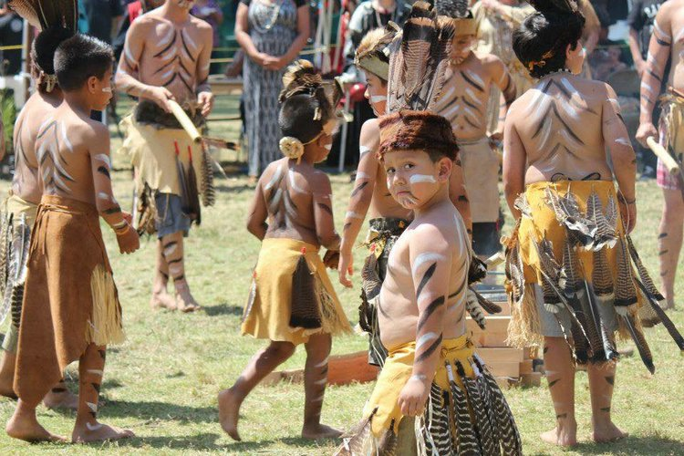
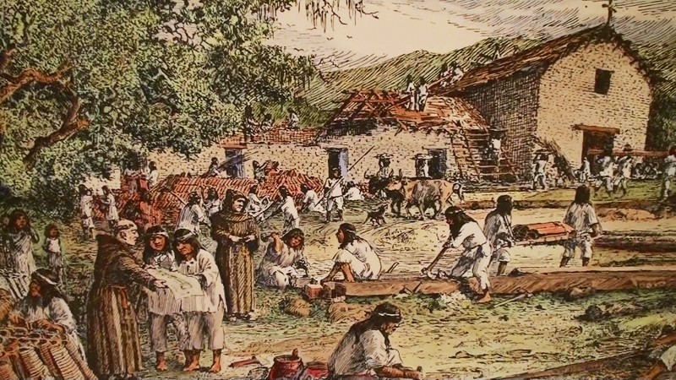
Land Acknowledgement
Who was here before us?
This Photo by Unknown Author is licensed under CC BY-SA
Notes:
We are gathered today on the traditional land of the Ramaytush Ohlone peoples, the original inhabitants of Los Altos Hills. I ask you to join me in acknowledging this community, their elders both past and present, as well as future generations. We, the leaders of the Foothill-De Anza Community College district, also acknowledge that the district was founded upon unceded land, and that under the flag of education, our instructors and students violated graves of the Ramaytush Ohlone. We hereby commit to working to dismantle the ongoing legacies of both of those takings, and the usurpation of the other rights of the people who once lived here.

Slide 2
R&R Meeting Norms (from E&E)
Ask questions for clarification to help avoid making assumptions.
Make sure everyone’s voice is heard.
Step up and step back.
Listen actively without interrupting.
Clarify when you are advocating vs offering an idea.
Say it now, in the room. Avoid waiting till later to raise an issue.
All voices count. All opinions are valid, and offer reasoning behind your thinking.
Be honest – speak your truth as you see it. Use “I” phrases, and avoid assuming to speak on behalf of others.
It’s OK to reflect and change your mind.
Zoom: Chat box can be used for comments and questions. They will be monitored by a tri-chair to verbalize and add to the record.
Zoom: Raise your hand in the Participants box or make a note in the Chat Box when you have a question.

