Slide 1
2012 Summer Bridge Math Program:
Enrollment and Course Success Rates
Basic Skills Workgroup
May 2, 2013
E. Kuo and M. Navi
FHDA IR&P

Slide 2
Overview
Two week summer program: July 9-19, 2012
  Emphasis on Math
  Goal: provide a refresher course to help boost math placement
  Coupled with Counseling 50
73 students began program
66 completed program

Slide 3
Fall 2012, Winter 2013 and Spring 2013 Enrollment
5 non-completers enrolled in
fall and winter (same students),
No math. One enrolled & successfully
Passed English 1A in fall
3 non-completers enrolled in spring (also enrolled in fall and winter):
One is taking Math 220 in spring (no Math in fall/winter)
One enrolled in fall, winter, spring (no math)
One same student who took 1A in fall (no Math in winter/spring)
66 enrolled
61 enrolled
59 enrolled
61 completed Summer Bridge
55 students enrolled
in fall and winter
52 students enrolled
In fall, winter & spring
1 enrolled in Math
56 completed Summer Bridge
56 completed Summer Bridge
42 enrolled in Math
Enr. In Eng 209, no math
Math placement: NCBS 401A
1 Winter only
34 enrolled in Math
1 Spring only*
27 students enrolled
in Math in fall and winter
13 students enrolled
in Math in winter and spring
21 enrolled in Math
6 Fall only
3 with Math,
3 without Math
The three who enrolled in math were unsuccessful (10, 220, 235)
Fall
2012
Winter
2013
Spring
2013
No enrollment in fall and winter; taking English 1A
Notes:
The number of Math enrollment in shrinking (F12=42 vs W13=34 vs S13=21).
The number of continuous enrollment is shrinking (F12W13= 27 vs W13S13= 13).
No NCBS in spring.

Slide 4
Overview Fall 2012 to Spring 2013 Enrollment
Success Rate
Compared to Fall 2012, where enrollment was centered in the Language Arts and PSME divisions, in Winter enrollment was more evenly distributed among Language Arts, Social Sciences and PSME divisions and in Spring enrollment is now more evenly among Social Sciences and Language Arts and Physical Education.

Slide 5
Overview Fall 2012 to Spring 2013 Enrollment
Math Enr.
ENGL Enr.
At the department level, enrollment is more concentrated in ENGL, MATH and PHED.
However, the enrollment in above mentioned departments had declined from fall 2012 to spring 2013.
Notes:
Enrollment in math in spring is half of enrollment in fall (F12=42 vs S13=21). However, enrollment in English is more (F12=47 vs S13=37). Success rate in English in also higher (81% success).

Slide 6
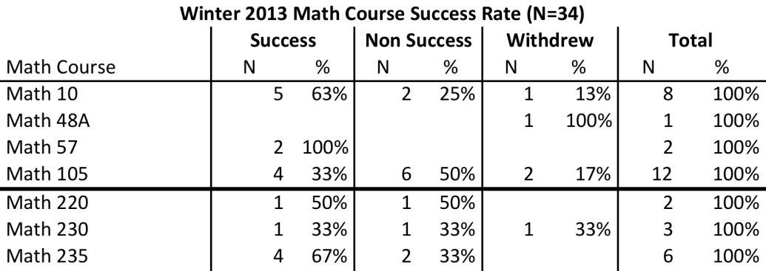
Summer Bridge Cohort Math Course Progress
Fall enrollment
2 x Math 220, passed with a “B” and “C”
73
Fall enrollment
2 x Math 220, passed with a “C”
2 x Math 105, withdrew
2 x Math 105, didn’t pass
66
Completers
42
21
Winter only
Total number enrolled in the program
Non Success
7
17
Non Success
4
Spring only
10
Winter Repeaters
Repeaters
4
21
4
Fall Repeaters
Enrolled in math
17
17
9
Success
Next course enr.
Success
Next course enr.
Summer Bridge
2012
Fall
2012
Winter
2013
Spring
2013
Notes:
From 21 students who were not successful in their math courses in fall:
10 students are repeating the math courses (48%); majority in higher level math (10, 105)
8 students enrolled in non math courses (38%)
3 students didn’t register in winter 2013 (14%)
From 21 students who succeeded in their math courses in fall:
17 students enrolled in next level math course (81%); majority in math 105
4 students enrolled in non math courses (19%)
From 17 students who succeeded in their math courses in winter:
9 students enrolled in next level math course (53%)
7 students enrolled in non math courses (41%)
1 student didn’t registered in spring 13 (6%)
From 17 students who were not successful in their math courses in winter:
4 students are repeating the math courses (24%)
12 students enrolled in non math courses (70%)
1 student didn’t registered in spring 13 (6%)
Math 10 enrollment in Winter 2013: 4 out of 8 enrolled in next course from fall, 4 out of 8 repeated fall course.
Math 105 enrollment in Winter 2013: 7 out of 12 enrolled in next course from fall, 4 out of 12 repeated fall course, 1 out of 12 took Math for the first time.
Math 10 Success in Winter 2013: 2 out of 5 enrolled in next course from fall, 3 out of 5 repeated fall course.
Math 105 Success in Winter 2013: 3 out of 4 enrolled in next course from fall, 1 out of 4 took Math for the first time.

Slide 7
Students continuously enrolled in Math (N=8)
Fall 2012
Winter 2013
Spring 2013
Math 220
Math 220
Math 220
Math 220
Math 220
Math 105
Math 105
Math 105
Math 105
Math 105
Math 105
Math 105
Math 105
Math 105
Taking Math 105 since F12; repeating it in W13 and S13
Students achieved
college level:
  One has 2 level increase
  One has 1 level increase
  One has no level increase
  One doesn’t have pre and post data
50% Math 105 failure rate
Math 10
Math 10
Math 105
Math 105
Math 48A
Math 48A
Math 48A
63% Achieved College Level Math (N=5)
Math 108
Math 10
Math 11
Note: 6 out of 8 students have pre and post placement data
Notes:
The students who didn’t pass Math 105 in W13 are repeating in Math 105 in S13.
From 8 students who continuously enrolled in Math, 5 students reached college level math (completed math 105 and 108 successfully) (63%)
From SB completers (N=66), 12 students reached college level math (completed math 105 or same successfully) (18%)
4 students who succeeded to college level math:
One has 2 level increase
One has 1 level increase
One has no level increase
One doesn’t have pre and post data
The one with constant nonsuccess from fall to spring had 3 level increase (repeating Math 105 from fall through spring)

Slide 8
Summary
Majority of students are enrolled in Spring 2013 (N=56, 92% )
Math enrollment has dropped (F12 N=42, W13 N= 34, S13 N=21).
53% of students who succeeded in their math course in Winter are taking next level math in Spring.
Math passing rate is consistent in fall and winter (50% )
Increase in Math placement levels does not appear to necessarily translate into higher success at the math courses.
For statistical analysis bigger group is needed.

Slide 9
Fall 2012 & Winter 2013 Course Success
3 PHED courses were excluded due to missing grades.
LA had 88% course success rate in F12
PE had 96% course success rate in W13
PSME had 50% course success rate in F12 and W13
Notes:
N=61 SB completers in F12 and 56 SB completers in W13

Slide 10
Fall 2012, Winter 2013 & Spring 2013 Math
½ of NCBS401A students in F12 enrolled in MATH 235 in W13

Slide 11
Fall 2012, Winter 2013 & Spring 2013 English
Notes: ENGL242A is a corequisite with ENGL1S, and ENGL242B is a corequisite with ENGL1T, so two students are double counted in fall and
three students were double counted in winter. And one student was double counted in spring. Note that out of the 7 students enrolled in ENGL 209 in W13, 3 are repeating the course and out of 9 students enrolled in ENGL 110 in S13, 2 are repeating the course .
Notes:
45 students out of the 61 students who completed Summer Bridge enrolled in an English course in fall (74%).
39 students out of 56 students who completed Summer Bridge enrolled in an English course in winter (70%).
36 students out of 56 students who completed SB enrolled in an English course in Spring (
Students appear to be progressing through English sequence.
Are the ENGL209 students repeaters? There are total of 7 students who are taking 209.
3 of them are repeaters (1withdrew, 2 failed)

Slide 12
Summer Bridge Placement Methodology
Summer Bridge Completers with Pre and Post test data (N=44)
  For analysis purposes, two students with “review and retest” placement result either before or after the program were excluded (N=42)
Students’ pre-test placement were based on the date closest to the start of the program to capture the most immediate effect of the program
Students’ post-test placement were taken at the end of the program (on 7.19.2012)
Placement level increase was calculated as follows:
  Math 10: college level
  Math 105, 108: One level below college
  Math 220: Two levels below college
  Math 230, 235: Three levels below college
  NCBS 401A: Four levels below college
Notes:
Just in case they want to know the methodology for calculation for placement level increase.

Slide 13
Fall 2012 Math Course Success
Students enrolled in Math 108, 217, 220 and 235 had higher success rates, where over half of students passed the course.
Over half of the students who were not successful in their math course experienced success in their other courses (13 out of 19 students).
Notes:
Just in case they want to know the enrollments in fall 2012.

