Slide 1
Foothill College
Educational Master Planning
June 9, 2015
Notes:
Dan

Slide 2
Agenda
Meeting Overview
EMP draft goals review
Feedback received
Goal review
Future vetting
Next steps in the planning process for PaRC
Typical EMP Table of Contents
EMP Leadership Team
Mission Statement and Core Values
College’s integrated planning cycle
Short-Term Action Plans
Integration with program reviews
Farewell
Notes:
John

Slide 3
EMP Goals Review

Slide 4
Future Vetting of College-wide Goals
One more opportunity for college-wide feedback
Finalize goals by end of June?

Slide 5
Next Steps in the EMP Process

Slide 6
Sample Table of Contents
Executive Summary
Integrated Planning Process
Environmental Scan
Online Survey Results
Qualitative Input Summary
Labor Market Analysis
Enrollment Management Analysis
Growth Forecast and Future Space Needs
Institutional Goals

Slide 7
EMP Leadership Team - Recommendations
Should not fall on one person’s shoulders
Include a senior administrator
Include a faculty member
Broad shared governance representation
Not too large a group – these are the leaders
PARC will continue to serve as the steering committee

Slide 8
Mission Statement and Core Values
Do we need to revisit?
Can be a parallel process in the fall

Slide 9
Update College Planning Cycle
Does this need to be reviewed?
Can be parallel process in the fall

Slide 10
Short-Term Action Plans
Implements EMP overarching goals
Identifies specific short-term measurable objectives
Measurable
Timelines
Champions (ultimately responsible individuals)
Relatively short time frame (can be one-three years)

Slide 11
Integration with Program Reviews
Includes department and area program reviews
How are they integrated?
Working toward common goals

Slide 12
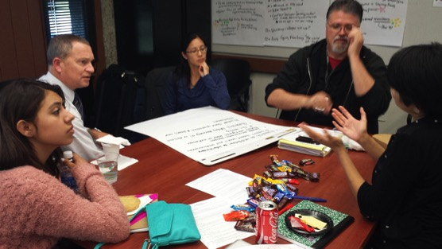
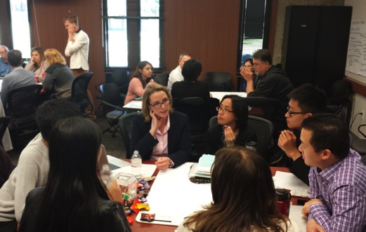
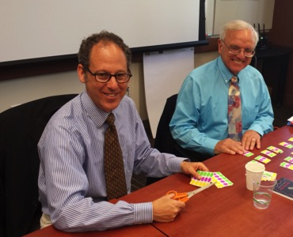
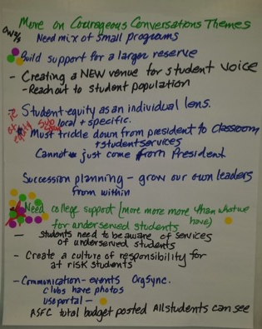
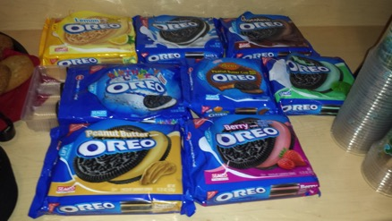
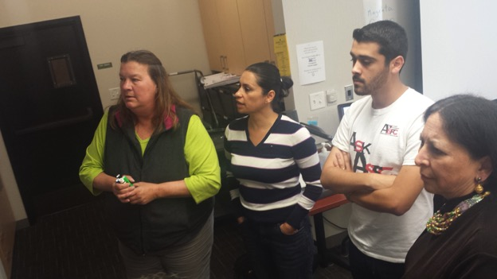
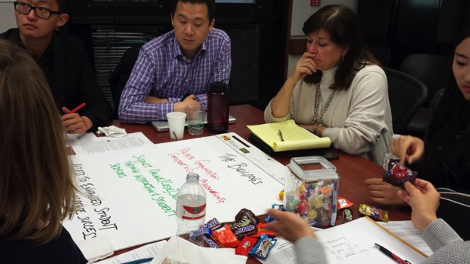
Farewell & Thank You!

