Slide 1
Multi-Year
Budget Projections
Presentation to the
Foothill College PaRC
June 18, 2014
Kevin McElroy, Vice Chancellor, Business Services
Hector Quinonez, Executive Director, Fiscal Services
Joni Hayes, Director, Budget Operations

Slide 2
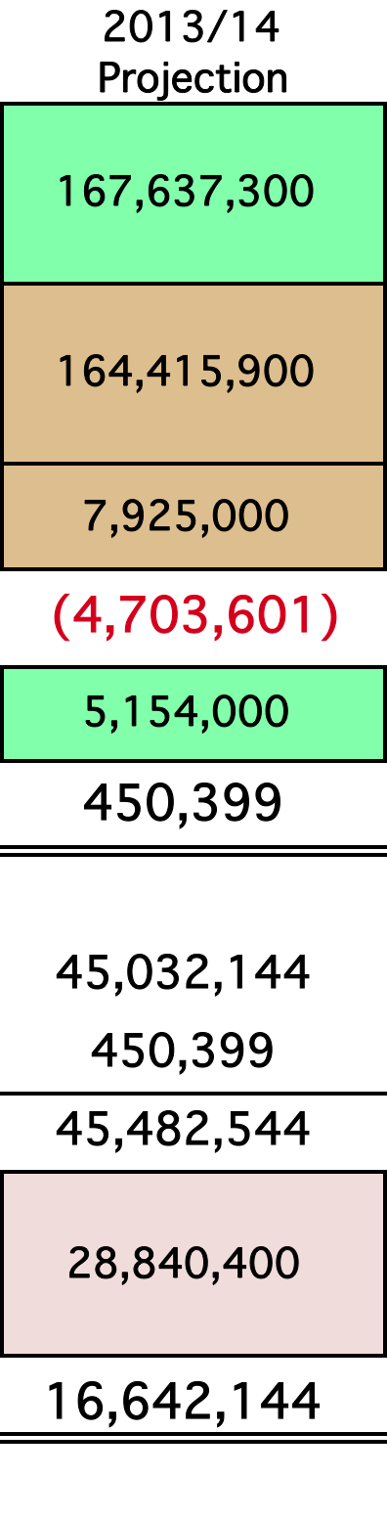
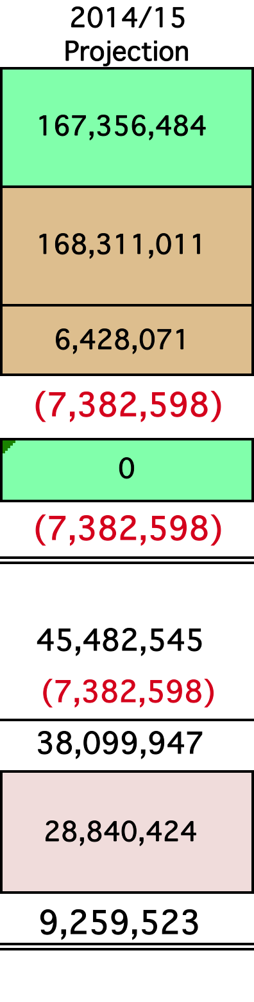
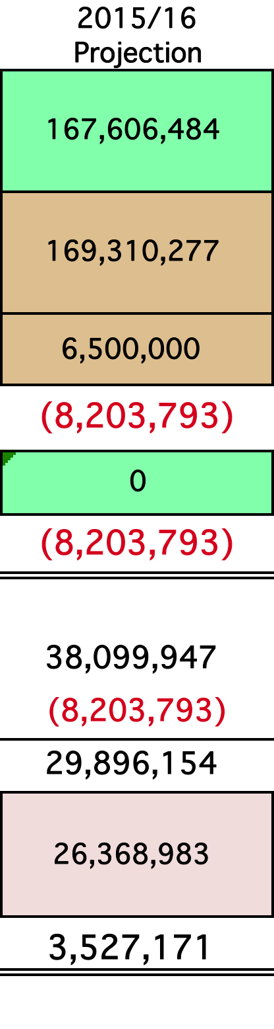
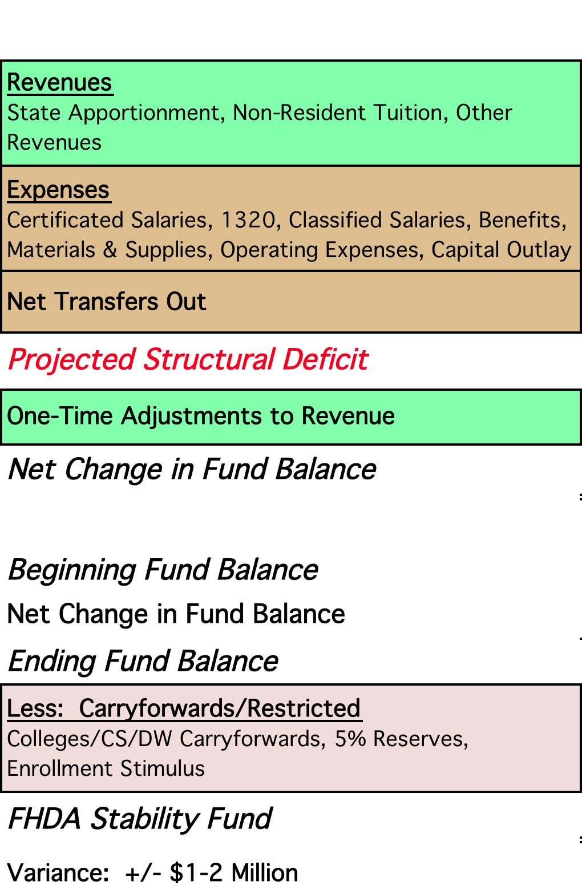
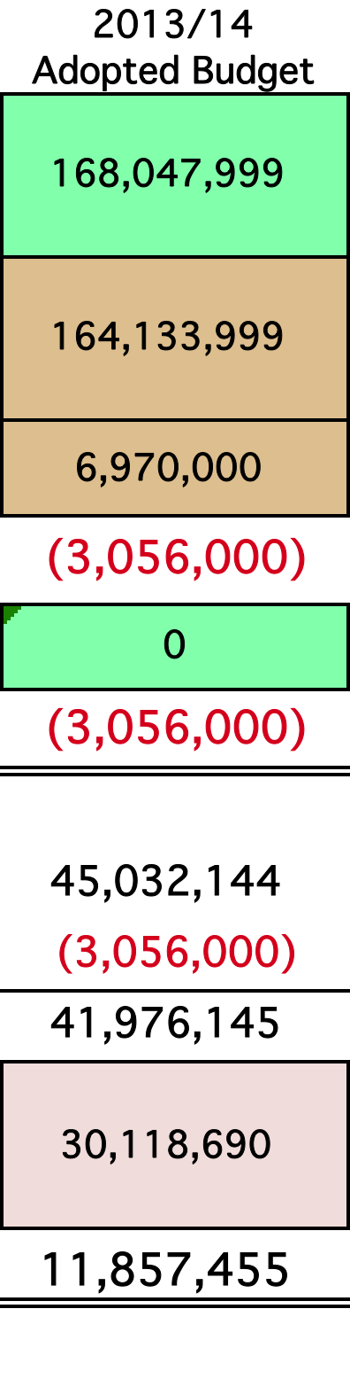
Foothill-De Anza Community College District Multi-Year Projections for the
General Purpose Fund (Fund 114)

Slide 3

Thank you for your time.
Questions?
BIG CHALLENGES AHEAD….
BUT WE HAVE PREPARED WELL TO THOUGHTFULLY DEVELOP OUR PLANS GOING FORWARD.
Contact: Kevin McElroy, Vice Chancellor, Business Services mcelroykevin@fhda.edu
Contact: Hector Quinonez, Executive Director, Fiscal Services
quinonezhector@fhda.edu
Contact: Joni Hayes, Director, Budget Operations
hayeslampreyjoni@fhda.edu

