Slide 1
Institutional Effectiveness Partnership Initiative (IEPI)
GOAL: advance colleges’ institutional effectiveness
enhance system’s ability to serve students effectively
reduce accreditation sanctions and audit issues
SB 852

Slide 2
Technical Assistance
(upon request)
Professional Development Opportunities
Indicator Framework: GOALS
(college/district)
IEPI
Must complete and post to Chancellor’s Office by June 30, 2015
Notes:
Three pieces of the IEPI

Slide 3
Indicators / Goals Framework
Student Performance and Outcomes
Accreditation Status:
Fully Accredited, no action
Fiscal Viability:
District $ number
Programmatic Compliance with State and Federal Guidelines: “Unmodified”

Slide 4
Fiscal Viability:
Fund balance as percentage of total expenditures
Salary and benefits
Annual Operating Excess/(Deficiency): net inc. or dec. in general fund balance
Cash Balance

Slide 5
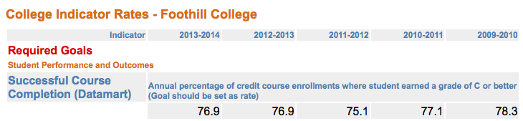
Most colleges will set a goal for course completion rate
https://misweb.cccco.edu/ie/CollegeRates.aspx
What should our goal be? (short term)
Next year (medium/long term): Goals for course completion (success) at online and department level?
How many more students need to be successful to meet our goal?
Notes:
Back to our five year high?
I think we can work with the overall course success number and then consider the success numbers at the online and department levels next year (as we are expected to have both short and long term goals moving forward). We need to frame this course success goal discussion so that it does not appear to be just a rubber stamping of more passing grades. Additionally, should we get this on the agenda at Academic Senate?

Slide 6
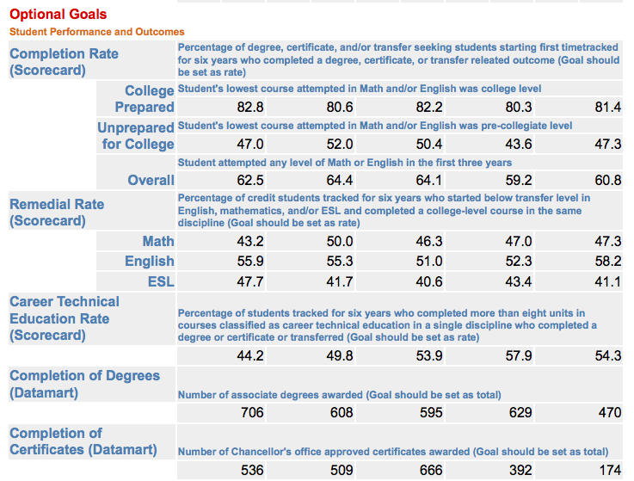
https://misweb.cccco.edu/ie/CollegeRates.aspx

