Slide 1
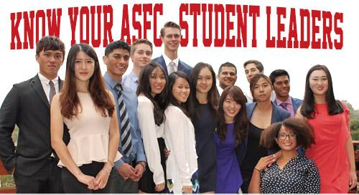
ASFC Winter 2016 Update

Slide 2

Presentation overview
Conferences
Sustainability
Bridging the Gap
Board Updates
  OBD
  Budget
  Senate Board
Looking Forward
  Financial Aid Collaboration

Slide 3
California Community College Student Affairs Association (CCCSAA)
20 students attended
Session highlights
Networking and problem solving with other ASO’s

Slide 4
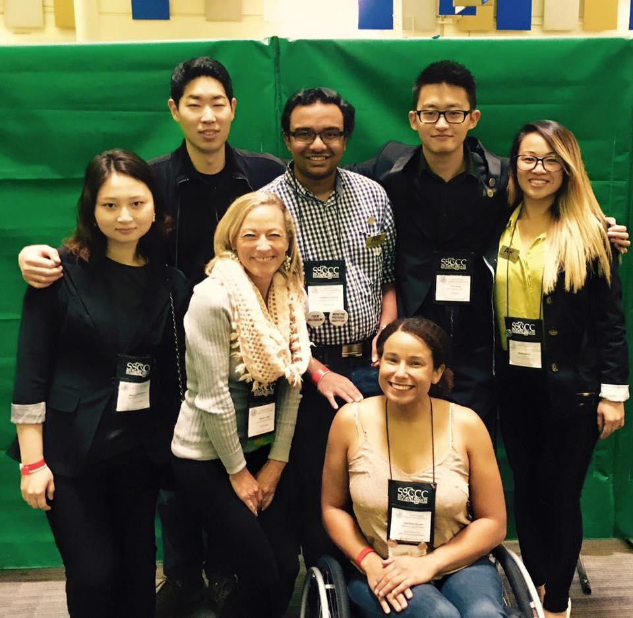
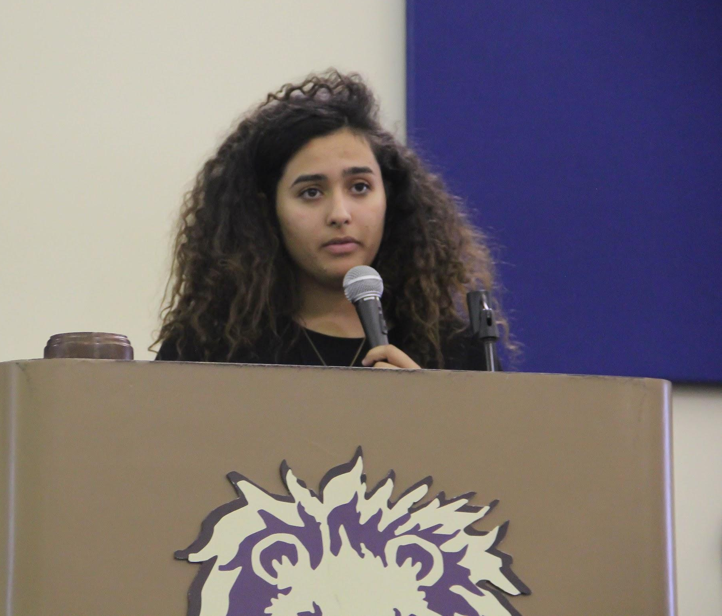
SSCCC Fall General Assembly
Dahlia Salem is a Foothill student and the first president of SSCCC to be a woman of color
6 additional Foothill students attended
2 students took and passed the National Association Parliamentarians [NAP] exam
Left, Foothill delegation. Below, Foothill Student and President of the SSCCC, Dahlia Salem

Slide 5

Sustainability...going green by going digital
OBD leading the charge by going all online for club and event forms.
ASFC continuing the trend by going online and putting the application for student government positions on OrgSync.

Slide 6

Bridging the Gap
Strengthening relationships between De Anza and Foothill

Slide 7
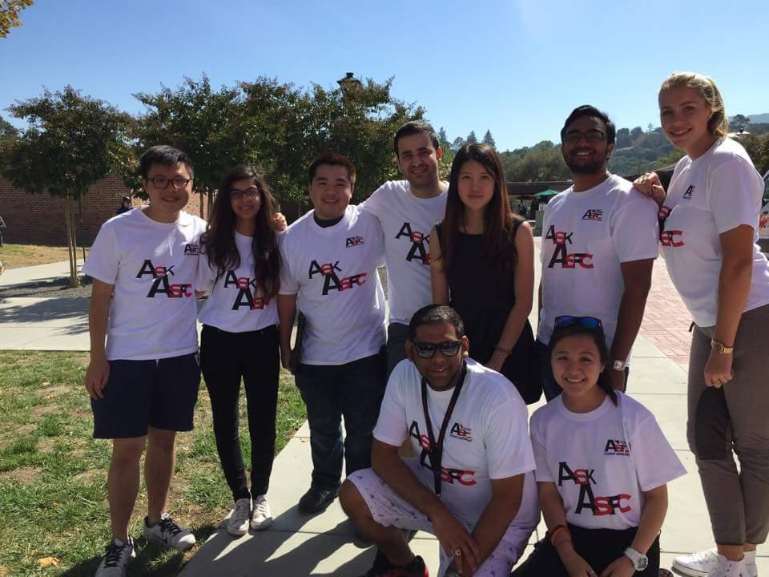
Organizational Board of Directors (OBD)
58 clubs activated during Fall quarter
Successfully implemented 2nd Club Day
Streamlined weekly board meetings
Melody Ye, center, with ASFC volunteers on Club Day

Slide 8
Budget Committee
Has overseen three heritage month budget request, so far
Practiced transparency with student body funds and keeping the public up to date on requests
Working on the ASFC 2016-2017 budget

Slide 9
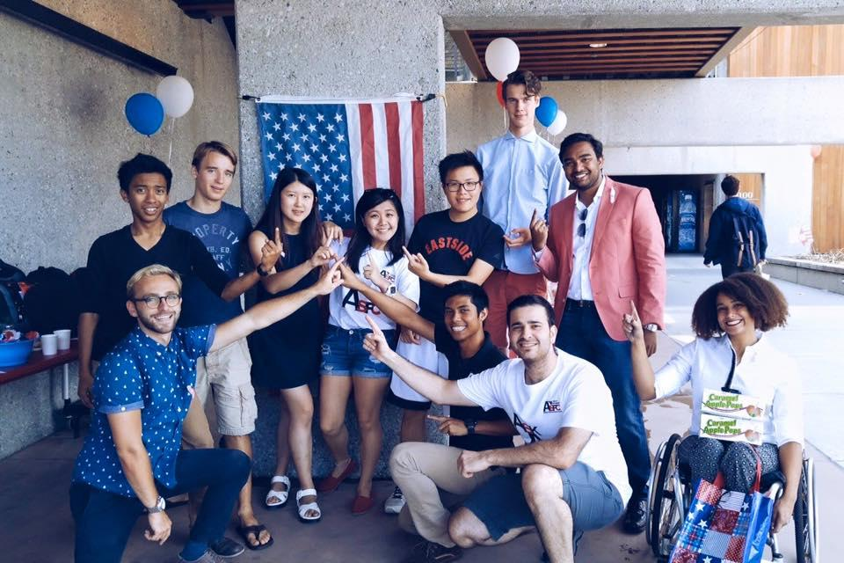
Senate Board
Political Awareness Day with guest speaker Assemblymember Rich Gordon -October 2015
Foothill students volunteer at Assemblymember Evan Low, FAPAC event -October 2015

Slide 10
Senate Board
Work on revamping the Food Bank, solutions for homeless students, and student advocacy
Meditation Room open for students to use
Recruitment for the FACCC A&P conference this February in Sacramento

Slide 11
Financial Aid Collaboration
ASFC is looking into collaborating with the Financial Aid office on marketing Foothill scholarship opportunities
President Liu working on implementation of the ASFC scholarship

Slide 12
ASFC Fall 2015 Campus Council

