Slide 1
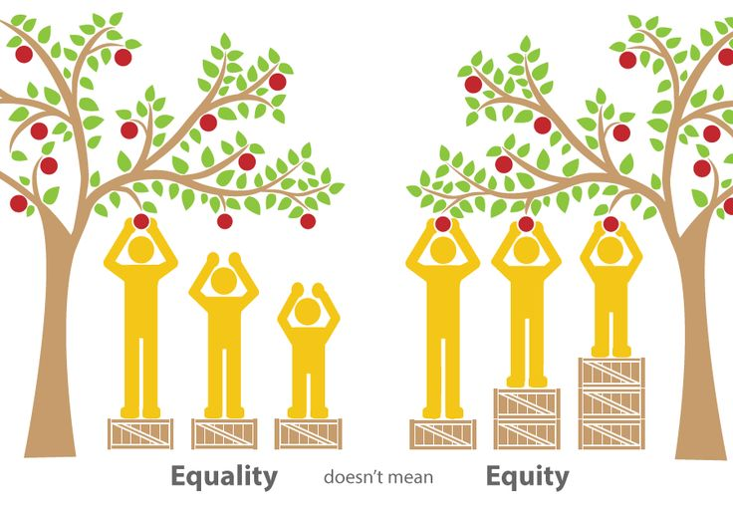
2015-2016 FOOTHILL COLLEGE STUDENT EQUITY PLANNING
Andrew LaManque Paul Starer
Carolyn Holcroft Hilda Fernandez

Slide 2
Agenda
I. Santa Clara County Regional Context--Andrew LaManque
II. Foothill Educational Master Plan Goals
w/ a focus on Equity--Carolyn Holcroft
III. Foothill Planning Process--Hilda Fernandez
IV. Foothill Major College Initiatives--Paul Starer
Foothill Professional Development--Paul Starer
VI. Q & A
Notes:
Rowena

Slide 3

Equity Planning at Foothill College:
Addressing the Needs
Foothill College Students: Self-reported Income
Low income
(< $25,000)
Notes:
Andrew

Slide 4
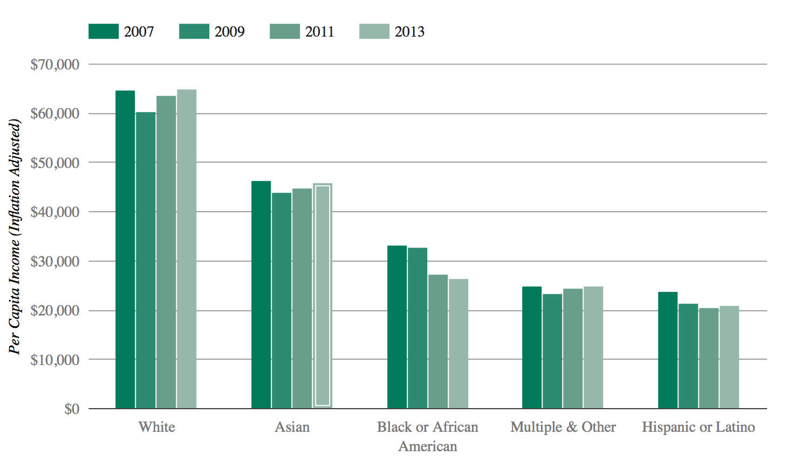
Per Capita Income in Santa Clara &
San Mateo Counties
In 2013, African Americans and Latinos had ~ ½ the per capita income of Whites and Asians
Notes:
Andrew

Slide 5
Equity Research
Program evaluation (what is working)
Student needs (“student voice”)
Disaggregate Data
Catalogs best practices from professional development activities
Disseminate and communicate results
Notes:
Andrew

Slide 6
Foothill College Master Plan Goals
Related to Equity
These goals are approached in a way that exemplifies Foothill College’s culture of innovation and problem solving, with emphasis on eliminating disproportionate impact among student groups:
Create a culture of equity that promotes student success, particularly for underserved students.
Implement activities to improve achievement of student outcomes among those population groups experiencing disproportionate impact.
Reduce barriers and facilitate students’ ease of access across the District and region.
Enhance support for online quality and growth for instruction and student services.
Collaborate with K-12, adult education and four-year institutions in ways that serve students and society.
Partner with business and industry to prepare students for the workforce.

Slide 7
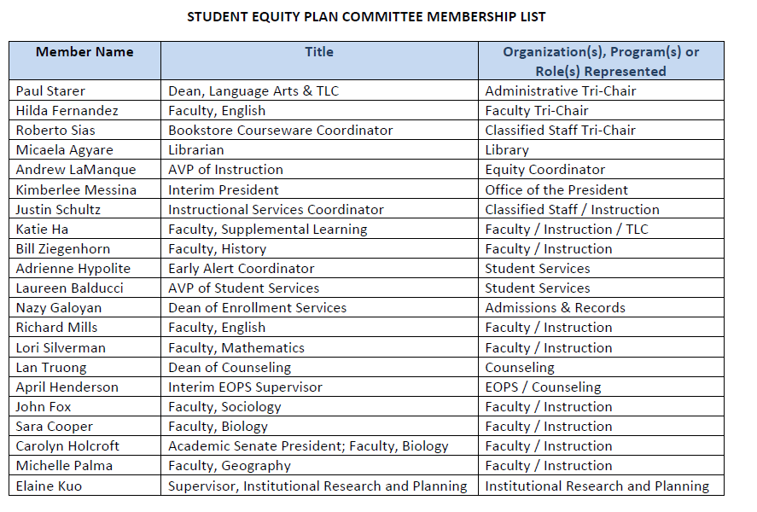
Foothill Student Equity Committee

Slide 8
Student Success Collaborative: Summer ‘15
3SP Advisory Tri-Chairs
Student Equity Workgroup Tri-Chairs
Basic Skills Workgroup Tri-Chairs
Identify areas of common interest
Collaboratively develop strategies to best meet student needs

Slide 9
Student Success Collaborative
(3SP, Basic Skills, Equity) Framework
  Three College-wide Initiatives:
  1) Comprehensive early alert program
  2) Mentoring program
  3) Targeted professional development

Slide 10
Student Success and Retention Team: Conceptual Framework
Students
Early Alert Coordinator
Early Alert / Retention Counselor
Part-Time Counselor
Prof Dev & Mentoring Program Coordinator
Supplemental Instructors
Student/Peer Mentors
Faculty Coordinator
Researchers
Notes:
MAKE SURE FOOTHILL SLIDES NEXT TO EACH OTHER

Slide 11
Planned Interventions
Foothill:
Early Alert System
Multiple Measures
Embedded Tutoring
FYE
Mentoring Program

Slide 12
Professional Development Examples
FOOTHILL
Jan. 14: Documentary Screening and Panel Discussion – “White People,” by Jose Antonio Vargas
Feb. 26: Francis Kendell
Summer 2016: Teaching and Learning Academy on implementing classroom equity practices

Slide 13


