Slide 1
Institutional-Set Standards and Goals:
ACCJC Annual Report and
Institutional Effectiveness Partnership Initiative (IEPI) v2
March 16, 2016
Planning and Resource Council (PaRC) Meeting
E. Kuo
FH IR&P

Slide 2
Overview
Institutional standards (ACCJC)
  Targets the college should annually meet and easily exceed
  Minimum levels of achievement
Institutional goals (IEPI)
  Advance institutional effectiveness
  Aspirational levels of achievement

Slide 3
Foothill’s Approach
Data
  Most recent term/year (Fall 2015, 2014, 2013)
  Longitudinal (2012-13 to 2014-15)
Sources
  CCCCO Data Mart, Student Success Scorecard, FHDA IR&P, FH Workforce Development & Institutional Advancement, CCC Core Indicator Reports
Discussion
  PaRC, Workforce Workgroup
  Documentation

Slide 4
Institutional Standards

Slide 5
Setting the Standards
Three-year trend
Three-year average
Calculate 75% of three-year average

Slide 6
Student Course Completion
Standard last yr: 57%
Change: 0%
Completion based on passing course with A, B, C, or P grade; includes all credit courses offered in Fall term

Slide 7
Student Program Completion
Standard last yr: 757
Change: +11(+<1%)
Number of AA, AA-T, AS, AS-T and Certificates of Achievement
Students counted once regardless of how many awards granted

Slide 8
Student Degree Completion
Standard last yr: 448
Change: +47(+10%)
Number of associate degrees

Slide 9
Student Certificate Completion
Standard last yr: 399
Change: -7 (-<1%)
Number of Certificates of Achievement

Slide 10
Student Transfers to Four-Year
Standard last yr: 817
Change: +32 (+4%)
CSU transfers
UC transfers
In-State Privates and Out-of-State transfers (transfer volume on Data Mart)

Slide 11
Additional (CTE) Standards
Licensure exam pass rate
Job placement rate
Initiate discussion at Workforce Workgroup mtg (3/8)
PaRC review and approval (3/16)

Slide 12
Licensure Exam Pass Rate
Pass Rates Standards
Relatively Consistent
Source: FH Workforce Development and Institutional Advancement, FH CTE Programs, Division of Apprenticeship Standards (DAS)
*Based on state written and practical exams; **Based on national and state exams; ***Based on first attempt

Slide 13
What is “reasonable” job placement rate?
Source: California Community College Core Indicator Report information for 2015-16, 2014-15, and 2013-14 Fiscal Planning [CCCCO MIS data, EDD Base Wage File]
ACCJC flagged programs with N/A or placement below 40% (8/2015 memo)
College is on enhanced monitoring

Slide 14
For Discussion
What is reasonable job placement?
How to determine?
  Cohort based vs. non-cohort programs
  Reporting current programs only

Slide 15
Proposed job placement reporting methodology (WWG)
Source: California Community College Core Indicator Report information for 2015-16, 2014-15, and 2013-14 Fiscal Planning [CCCCO MIS data, EDD Base Wage File]
CTE programs with less than 10 completers to be removed (8/2015 ACCJC memo)
Report the avg for non-cohort programs
EMT to use program survey data

Slide 16
Student Job Placement Rate
*Career Technical Education Allied Health individual program’s employment survey.
Source: California Community College Core Indicator Report information for 2016-17, 2015-16 and 2014-15 Fiscal Planning
[CCCCO MIS data, EDD Base Wage File]

Slide 17
Institutional Goals

Slide 18
Setting the Goals
Three-year trend
Three-year average
Calculate one-year goal based on 1% increase of three-year average
Calculate six-year goal based on 3% increase of three-year average

Slide 19
Successful Course Completion
Goal last yr: 77.1%
Change: 0%
Emphasis on decreasing gap among disproportionately impacted groups by 3-percentage points. [EMP, Student Equity Plan]

Slide 20
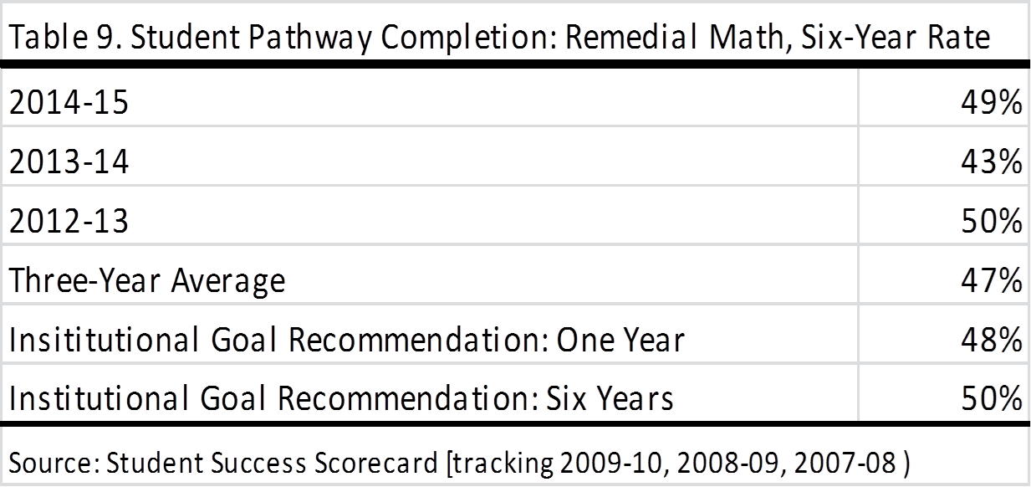
Remedial Rate-Math
New Indicator
Emphasis on decreasing current gaps among disproportionately impacted groups by at least half. [EMP, Student Equity Plan]

Slide 21
Remedial Rate-English
New Indicator
Emphasis on decreasing gap among disproportionately impacted groups by 3-percentage points. [EMP, Student Equity Plan]

Slide 22
Remedial Rate-ESL
New Indicator
Emphasis on decreasing current gaps among disproportionately impacted groups by at least half. [EMP, Student Equity Plan]

Slide 23
Additional (District) Goals
Accreditation status: Fully accredited-no action
Fund balance: 5%
  Ending unrestricted general fund balance as percentage of total expenditures
Programmatic compliance: Unmodified
  As identified in an annual independent audited financial statement
    Audit findings
    State Compliance
    Federal Awards/Compliance

Slide 24
Considerations
Move to a five-year trend analysis
Revisit standards and goals rates annually
Consideration of program-level completion goals

