Slide 1
Foothill College
Program Review Committee (PRC) Recommendations to PaRC
Spring 2016
Justin Schultz; Andrew LaManque‎; Vinita Bali‎; Kevin Harral‎; Jiatong Li‎; Simon Pennington‎; Cara Miyasaki‎; Craig Gawlick‎; Michelle Palma‎; Claudia Flores‎; Elaine Kuo

Slide 2
Comprehensive Program Review
Every 3 years
Covers multiple aspects of the program
Required for resource allocation requests

Slide 3
Program Review Committee (PRC)
3 Faculty members
3 Administrators
3 Classified Professionals
http://www.foothill.edu/staff/irs/programplans/index.php
http://www.foothill.edu/staff/irs/programplans/programreview.php
http://www.foothill.edu/staff/irs/programplans/prcminutes.php

Slide 4
Top 3 Program Review Complaints
We request resources year after year and never get anything
We are being asked to analyze data about our programs but we are not researchers
The prompts do not allow us to properly explain what we are doing

Slide 5
Why bother?
We spend dozens of hours collectively on program review each year, what is the purpose, are we just doing it for accreditation?

Slide 6

Purposes of Program Review
Promote Program Improvement
Link Program Goals to Resource Requests
Assure (“to promise or say with confidence”) Program Quality
Program review is the process by which instructional and non-instructional programs systematically assess themselves to ensure currency, relevance, appropriateness, and achievement of stated goals and outcomes related to student learning and institutional effectiveness.
Source: PRC Charter
Source: adapted from http://www.chea.org/

Slide 7
Its About Improvement!
“even great programs can
keep improving!"
Carolyn Holcroft, Foothill College Academic Senate President, October 31, 2014

Slide 8
Program Review Goals
Program review is an opportunity for the college to:
Examine the extent to which a program is meeting its mission and contributing to the college core missions;
Develop an understanding of the program’s strengths, successes and challenges;
Use data and evaluation findings to develop goals and actions leading to program improvement;
Help the college meet accreditation requirements and accountability mandates; and
Provide information to facilitate program-­‐ and college-­‐level planning and resource prioritization and allocation.

Slide 9
Comprehensive Program Review Steps
Program completes self review via the PR template
Dean and Vice President review and add their perspective
Program Review Committee (PRC) reviews
PRC Provides Feedback to PaRC and the Program
PaRC reviews and recommends next steps
Annual PR’s do not go to PRCFor
http://foothill.edu/staff/irs/programplans/index.php

Slide 10
3 year cycle
Comprehensive Program Review
Foothill College Comprehensive
Program Review Process
PRC
Provide a summary of their evaluation and recommendations on PR’s (including out of cycle) and Remediation Plans
Remediation Plan –
goals, benchmarks, timeline
OR a follow-up response to sections in need of clarification / rewriting
Green, Yellow, Red
Request for more Information and clarification
PaRC
Remediation
Suspension
Discontinuance
Yellow Red
President
Out of Cycle Review Based on Annual
Program Discontinuance Process
Green
OPC
Resource Allocation
Draft
October 30, 2014

Slide 11
Program Review Rubric
Each of the critical sections (Data & Trend Analysis, Institutional Standards, Student Equity, Program Goals, Outcomes Assessment, Outcomes Reflection) will be analyzed and evaluated based on the following criteria.
Green:
  Response is clear and addresses the question, AND
  Results document improvements in program practices, AND
  Any trends in the data are steady or increasing.
Yellow:
  Response is incomplete or unclear. OR
  Issues are identified along with ideas for improvement. OR
  Trends show a decline.
Red:
  Response is missing. OR
  Response identifies issues but does not demonstrate a viable plan for improvement. OR
  Trends show an abrupt change or persistent decline.
Purpose
--Provide feedback to all programs
--Identify programs with potential viability problems
“Improvement”
* the act or process of making something better
* a the quality of being better than before
b an addition or change that makes something
better or more valuable
http://www.learnersdictionary.com/definition/improvement
Notes:
Does the PR talk about plans or ideas to get better?
Does the writing in the section include any discussion about using the information to achieve better results?
Is the writing in the section used as an opportunity to talk about ways to make the program even better?

Slide 12
Program Review Rubric (Cont.)
Overall Rating (from the Program Review Committee Charter)
Green signifies the program is recommended to continue in the regular program review cycle.
Yellow signifies that trend analysis indicates the program is not meeting targets and/or indicators identified within the program review document, or that the program review document is incomplete.
Red signifies that trend analysis indicates a notable and persistent decline in viability, an abrupt change to one or more of the targets and/or indicators, or that a program previously categorized as yellow has not successfully implemented its remediation plan.

Slide 13
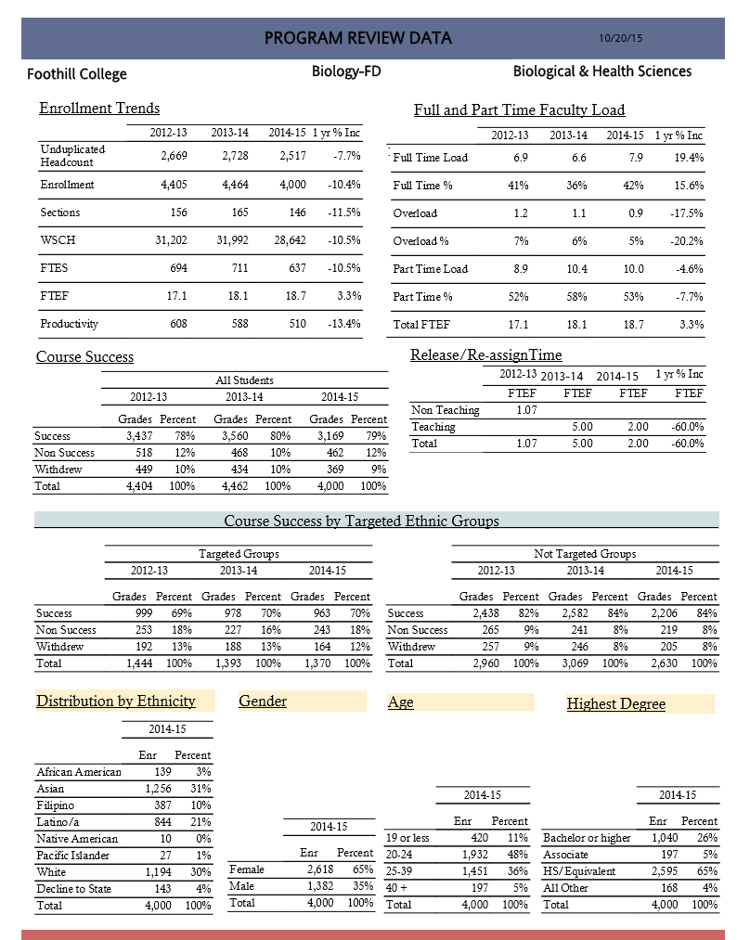

Slide 14
Winter 2016 Review
  Met with 11 departments for a discussion about their work.
  Discussed all reviews over a period of several meetings (average discussion time 20-30 minutes per department).
  Reviewed a total of 38 Comprehensive Program Reviews (15 hours of meetings).

Slide 15
Types of Comprehensive PRs Reviewed

Slide 16
Types of Responses

Slide 17
Equity Related Commendations (sample)
UNIT | PRC Recommendation to PaRC
Admissions and Records | PRC commends the department for doing a good job addressing student equity efforts and working to foster a sense of community for the students served.
Biology | PRC commends the department for its effort to achieve equitable outcomes for its students. The department has done so in a collaborative way that has involved part time faculty. This work has ranged from helping to organize the Teaching and Learning Summit, to reaching out for embedded tutors, to looking at alternative textbooks to reduce costs for students, to writing a WestEd Grant to pilot reading apprenticeships across the STEM fields.
Economics | PRC commends the department for its efforts to reach out to students to improve success rates, including through the use of embedded tutoring, and special programs (e.g. India).
Psychology | PRC commends the department for its equity efforts (e.g. embedded tutoring).
Athletics (Student Services) | PRC commends the department for its student equity efforts (counseling, progress reports, and mentorship by coaches).
General Studies - Science | PRC commends the Division Deans (2x) for getting together to discuss student equity effort across both divisions.
Pass the Torch | PRC commends the program for its assistance to underrepresented student populations and its contribution as an important part of the College’s equity agenda.
EOPS | PRC commends the program for its contribution to the College’s student equity efforts.
Dean – Physical Sciences, Mathematics and Engineering (PSME) | PRC commends the unit for a program review document that clearly outlined the division’s equity efforts.
Business and Education Partnerships | PRC commends the unit on serving a diverse range of students in the internship program.

Slide 18
Curriculum Related Commendations (sample)
UNIT | PRC Recommendation to PaRC
ESL | PRC commends the department on its work with Vocational ESL course development.
Economics | PRC commends the department for its innovative curriculum and its support for the campus-wide drive for equity.
Dean – Business and Social Sciences (BSS) | PRC commends the division for the exploration of a non-credit Social Science Research Writing course option.
Dean – Biological and Health Sciences (BHS) | PRC commends the division for the successful use of GoogleDocs for curriculum review and for taking the initiative to find a tool that worked well for the division (an example of the Foothill Innovation spirit!).
Women’s Studies | PRC commends the department for contributing to the diversity of subject matter available in the G.E. course offerings (particularly with the proposal to offer Women in Sports course).

Slide 19
SLO Related Commendations (sample)
UNIT | PRC Recommendation to PaRC
Accounting | PRC commends the department for its analysis of the SLO and PLO data.
Economics | PRC commends the department for the approach they have taken in assessing the PL-SLOs through the use of pre-tests and post-tests across various ECON courses.
Graphic and Interactive Design | PRC commends the department on the use of TracDat to enter in CL-SLO and PL-SLO assessments and reflections.
Psychology | PRC commends the department’s approach to PL-SLOs (via capstone course assessment).
Dean – Physical Sciences, Mathematics and Engineering (PSME) | PRC commends the unit for clear and thorough AU-SLO assessment and reflections.

Slide 20
Other Examples (not all!) of
Good Work
UNIT | PRC Recommendation to PaRC
Women’s Studies | PRC compliments the approach the department is taking in assessing the PL-SLOs through the use of pre-tests and post-tests across various courses.
English | PRC compliments the department on their student equity efforts and the discussion included in the program review associated with each of the initiatives. The department’s work and leadership in addressing the needs of our students is clear.
EOPS | PRC compliments the writers on their thorough and thoughtful SA-SLO assessment and reflection.
Krause Center for Innovation (KCI) | PRC congratulates the department on its contributions to the College Workforce Mission and for beginning to reach out to other parts of the College and increase awareness.
Pass the Torch | PRC commends both Natalia Menendez and Nicole Gray for their dedication and efforts in support of Foothill students.

Slide 21
Recommended Meeting with PRC
  To discuss recommendations …
  Business and Education Partnerships
  Classified Senate
  ESL
  General Studies – Science
  Physical Education

Slide 22
Recommended for Out-of-Cycle
  Classified Senate
  ESL
  General Studies – Science
  Kinesiology and Athletic Injury
  Physical Education
  Dean Fine Arts and Communications; Dean Student Affairs; President’s Office; Student Success and Outreach *
  * Due to organizational transitions

Slide 23
Program Outcomes Ratings (sample)
UNIT | PRC Recommendation to PaRC
Athletics (Student Services) | PRC rated the Outcomes Assessment and Outcomes Reflection sections of the program review documents as a yellow due to the lack of assessment of SA-SLOs (the lack of assessment was noted in program review document, as new SA-SLOs have been developed).
Educational Center (Middlefield and the Sunnyvale Center) | PRC rated the Outcomes Assessment and Outcomes Reflection sections of the program review document as a yellow due to the lack of assessment of AU-SLOs which was noted in TracDat.
English | PRC rated the Outcomes Assessment and Outcomes Reflection sections of the program review documents as a yellow due to the lack of assessment of PL-SLO # 2E within current 3-year cycle.
Environmental Horticulture and Design | PRC rated the Outcomes Assessment and Outcomes Reflection sections of the program review documents as a yellow due to very few 2014-15 reflections for HORT course-level SLOs (CL-SLOs).

Slide 24
Recommended Follow-up
UNIT | PRC Recommendation to PaRC
Athletics (Student Services) | PRC recommends that every athletics course have a completed assessment (CL-SLO) within the three-year program review cycle (2012-2015) and that the assessments be submitted to the PRC for review by June 15, 2016.
Apprenticeship | PRC recommends that the department submit an analysis of disaggregated program enrollment, course success, and award trends to PRC by October 15, 2016.
Business and Education Partnerships | PRC recommends the department develop a short document that more clearly articulates the role it plays meeting the college mission and supporting the college Educational Master Plan Goals. The document should include an expansion of the response regarding Community Education in Question 3B and be shared with PRC for review by June 15, 2016.
Classified Senate | PRC recommends that the department complete AU-SLO reflections for 2014-15 and sumit them for PRC review by June 15, 2016.
Educational Center | PRC recommends that the department complete the outcome assessments and submit them for PRC review by November 11, 2016.
English | PRC recommends the department work with the SLO Committee for assistance in conducting program level assessments and provide them for PRC review by June 15, 2016.
General Studies - Science | PRC recommends that Section 2E and PL-SLO assessment and reflection be completed and sent to PRC by June 15, 2016.
Physical Education | PRC recommends that the department complete the PL-SLO assessment and reflections as well as Section 1H and submit the materials to PRC by June 15, 2016.

Slide 25
From last year
  All programs recommended for out-of-cycle this year are recommended to continue on the regular cycle next year!
    Music - General
    Pass the torch
    Spanish
    Political Science
    Krause Center for Innovation

Slide 26
PRC Charge – College-wide Observations (coming soon!)
  “This summary may include observations of common patterns or themes, suggestions for reducing duplication of resources, and/or broader recommendations to the college that would increase institutional effectiveness.”

Slide 27
Questions?

