Slide 1
Student Equity:
Enrollment and Outcome Trends
Academic Senate Presentation
May 13, 2013
T. Margesson, M. Navi & E. Kuo
FHDA IR&P

Slide 2
Overview
Breakdown of regional, local population by ethnicity
Compared with the ethnicities represented in Foothill’s student population
Examine trend lines over 6 years
Report on how Foothill students are performing along state completion measures

Slide 3
Part I:
Foothill Students and Local Population

Slide 4
Foothill College Fall 2007-Fall 2012
Enrollment by Ethnicity
Notes:
There has been a net decrease in percentage of whites 40% to 36%
Increase in percentage of Hispanics 12% to 20%
Percentage of Asians has returned to 30% following a low of 22% in 2009
NOTE: Asians include PI and Filipinos
NOTE: Percentages do not total 100% as Native Americans, Other, Multi Racial and No Response categories are not included.

Slide 5
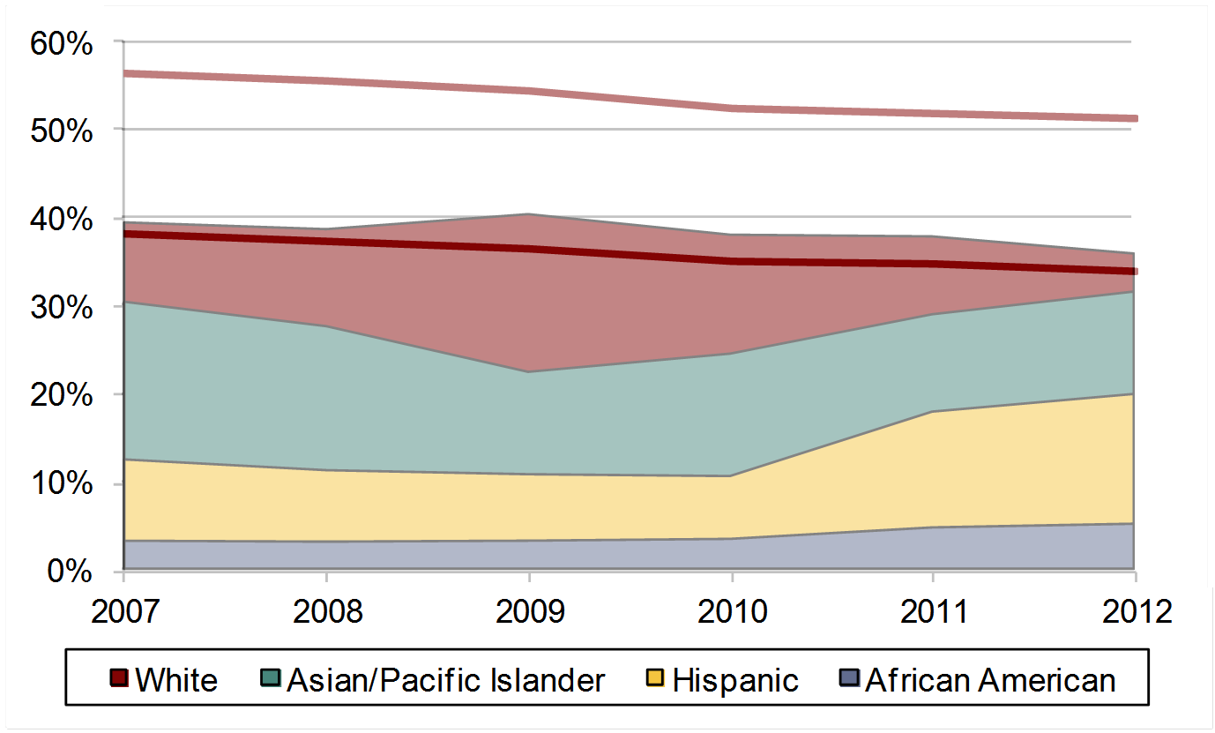
Foothill College Fall 2007-Fall 2012
Student Enrollment and Population
County and Service Area Overlay
Service Area
County
Notes:
Whites represent a higher percentage in Foothill’s service area than in Santa Clara County.
The percentage of white student enrollment falls between the level of Foothill’s service area and Santa Clara County, with enrollment more representative of the county percentage.
Percentage of White students enrolled has followed the decrease in Santa Clara county and Foothill’s service area.

Slide 6
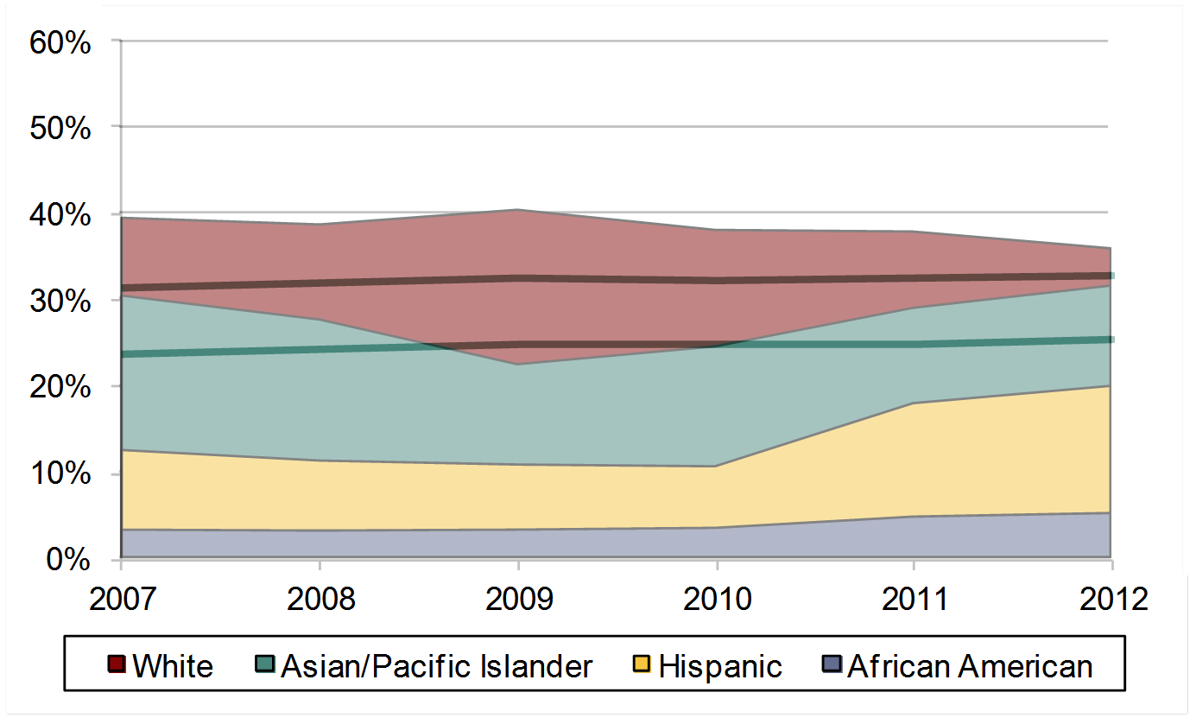
Foothill College Fall 2007-Fall 2012
Student Enrollment and Population
County and Service Area Overlay
County
Service Area
Notes:
Asian/Pacific Islanders have a higher presence in Santa Clara County than in Foothill’s service area.
Asian/PI student percentage has increased since 2009 while levels in region has stayed the same.
Asian/ Pacific Islander student enrollment falls between the level of Foothill’s service area and Santa Clara County, with enrollment more representative of the county percentage.

Slide 7
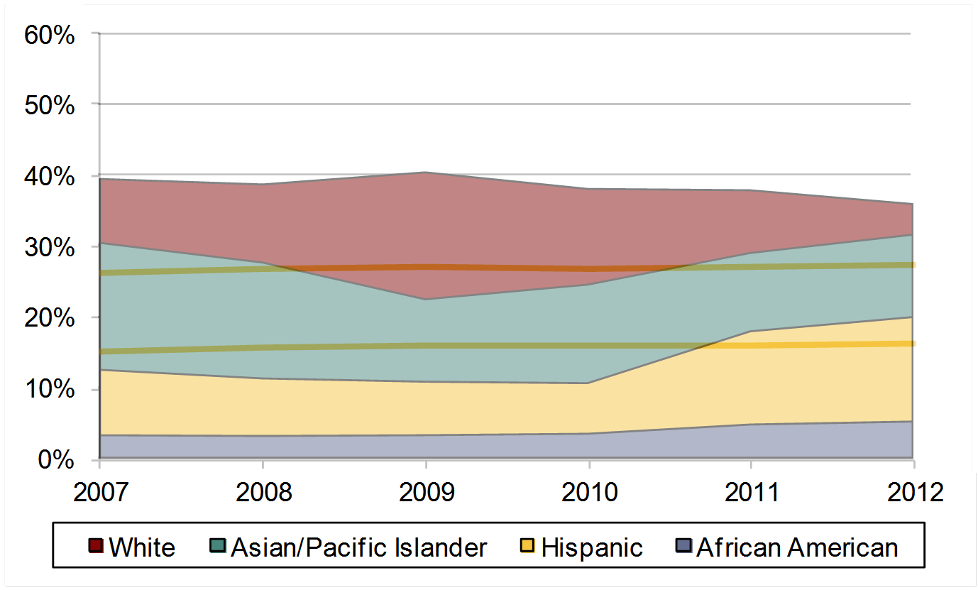
Foothill College Fall 2007-Fall 2012
Student Enrollment and Population
County and Service Area Overlay
County
Service Area
Notes:
A higher percentage of Hispanics are found in Santa Clara County than in Foothill’s service area.
While Hispanic enrollment has historically been below the level found in Santa Clara County and Foothill’s service area, from 2011 enrollment has become more representative of the percentages found in the region.

Slide 8

Foothill College Fall 2007-Fall 2012
Student Enrollment and Population
County and Service Area Overlay
Service Area
County
Notes:
The percentage of African Americans in Santa Clara County and Foothill’s service area have both been consistent around 3%.
The percentage of African Americans enrolled in Foothill has slowly been increasing and is higher than the percentages found in the region.

Slide 9
Foothill College Fall 2007-Fall 2012
Student Enrollment by Ethnicity
Notes:
Percentage of Filipino students has increased from 2.7% to 4.4%
Percentage of Native american students has remained less than 1%

Slide 10
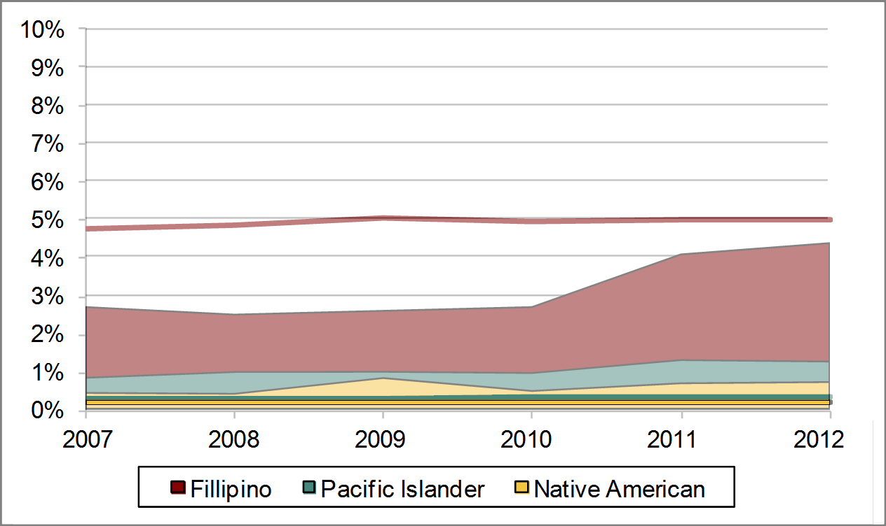
Foothill College Fall 2007-Fall 2012
Student Enrollment and Population
County Overlay
County Filipinos
County PIs
County Native Americans
Notes:
Student enrollment percentages for pacific Islander and native Americans is higher than the region
Percentage of Filipino students has increased but is still below that of the county

Slide 11
Part II:
Foothill Students and Employees

Slide 12
Total Enrollment
African American Enr.
Asian/Pac Isl Enr.
Filipino Enr.
Latino/a Enr.
White Enr.
IR&D District Website Fall 2007 to 2012
Notes:
The overall headcount of fall enrollments shows a relatively steady decline from 2007 to 2012 (-21%).
There was an increase in Latino (23%), African American (24%) and Filipino (27%) enrollment headcount.
The decline in student headcount is mainly due to decline in White (-30%) and Asian/P (-25%).
Decline in Whites and Asians noticed in Faculty (-10%) and Staff (-25%) headcounts.
However, the Admin headcount shows an increase (18%).
The increase headcount in Latino students’ enrollment mirrors the increase in Latino faculty (26%, the only faculty ethnicity that shows increase from 2007-2012).

Slide 13
Admin
Faculty
Latino/a Faculty
Staff
Notes:
Decline in Whites and Asians noticed in Faculty (-10%) and Staff (-25%) headcounts.
However, the Admin headcount shows an increase (18%).
The increase headcount in Latino students’ enrollment mirrors the increase in Latino faculty (26%, the only faculty ethnicity that shows increase from 2007-2012).

Slide 18
What do the numbers say?
Data shows us trend lines and historical patterns
Must consider how this information informs goals related to student equity
Ethnicity is just one piece of equity
  Exploration on other characteristics are needed

Slide 19
Part III:
Foothill Students and Outcomes

Slide 20

Placement at Below College Level
Source: FHDA IR&P, ODS
More Latinos are placing at a high rate at below college level in Math and English when compared to other groups.
FOOTHILL COLLEGE

Slide 21
Course Success and Retention Comparison
Source: CCCCO Datamart
Foothill continues to experience a higher retention and course success rate when compared to the statewide average.
FOOTHILL COLLEGE

Slide 22
Course Success Rates by Ethnicity
Other/Unk n includes Native American, Other, Unknown and Decline to State.
Source: FHDA IR&P
African American and Latino/a experience course success at a lower rate compared to other groups.
FOOTHILL COLLEGE

Slide 23
Online and Not Online Course Success
Source: FHDA IR&P
All students, regardless of ethnicity, appear to experience success at a lower rate in online courses.
FOOTHILL COLLEGE

Slide 24
College Profile
Over half of 2011-12 students are between ages 20 to 49
FT Faculty based on district figures
Asians, Hispanics and Whites compose over three-fourths of students enrolled
FOOTHILL COLLEGE

Slide 25
Who’s being counted?
Completion, Persistence and Attain 30 Units cohort definition:
  First-time students (w/valid SSN)
  6 units minimum earned (pass course)
  Attempt any Math or English in first three years
Foothill 2006-07 cohort: 958 students
  47% Female (451)
  85% Under age 20 (813)
  39% Whites (373)
  25% Asian (239)
  16% Latino/a (157)
Foothill had 2,054 new first-time students in 2006-07 academic year
FOOTHILL COLLEGE
Notes:
First time new students:
F06: 1,298
W07: 417
S07: 339

Slide 26
What outcomes are counted?
Completion cohort outcomes definition:
  Earned AA/AS
  Earned Certificate
  Transfer to four-year institution
  At least 60 transferrable CSU/UC units with minimum 2.0 GPA
  Within 6 years
FOOTHILL COLLEGE

Slide 27
What outcomes are counted?
Persistence cohort outcomes definition:
  Enroll in four consecutive quarters
  Within the first year of enrollment
Attain 30 Units cohort outcomes definition:
  Earned at least 30 units
  Within 6 years
FOOTHILL COLLEGE

Slide 28
Completion
Foothill Prepared
State Prepared
Foothill Overall
State Overall
Foothill Unprepared
State Unprepared
Prepared/Unprepared determined by lowest attempted Math or English course
FOOTHILL COLLEGE
Notes:
Prepared/Unprepared based on lowest attempted Math or English course.
If lowest attempted Math course was one below or college level, then student is “prepared for college.”
If lowest attempted English course was college level, then student is “prepared for college.”
If lowest attempted Math or English was below college level (two levels below or more in Math), then student is “unprepared for college.”
If student attempts both Math and English,if lowest of either is below college level, then student is “unprepared for college.”

Slide 29
Persistence
State Unprepared
State overall
Foothill Overall
State Prepared
Foothill Prepared
Foothill Unprepared
Foothill reports lower persistence rates when compared to state figures
About one-third of Foothill completers did not persist
FOOTHILL COLLEGE

Slide 30
Attain 30 Units
Foothill Prepared
Foothill Overall
State Prepared
FH Unprepared
State Overall
State Unprepared
Foothill’s cohorts tend to attain 30 units at a higher rate
when compared to state figures
Prepared students attain 30 units at a higher rate compared to those Unprepared
FOOTHILL COLLEGE

Slide 31
What’s the message?
System-level:
  Emphasis on defining completion as degree/certificate and transfer attainment
  Different outcomes among Prepared and Unprepared students
Institution-level:
  Decrease in cohort size over time
  Disaggregating data can lead to small groups of students
  Changes in courses (number and curriculum) affects what is included in the cohort
  How are we serving our students?
FOOTHILL COLLEGE

Slide 32
Part IV:
Student Voices

Slide 33
Student Support (Re)defined
Phase one of a three-year study
  Focus on student perspectives
Interviewed nearly 900 students
  Phone surveys, focus groups
Oversampled African American and Latino students
Thirteen CA community colleges

Slide 34
Student Support (Re)defined)

Slide 35
Key Themes
Acknowledge students as key agents in their own educational success
Speak directly to the need to teach students how to succeed
Underscore the importance of comprehensive service delivery to targeted populations
Recognize the important role the entire college community plays in student success, but emphasize the need for faculty leadership
Notes:
Student motivation
Teach students to be successful
Highlight the value of student supports
Provide comprehensive support to underrepresented populations
Emphasize the importance of the campus community

Slide 36
Connecting Target Students
African-American, Latino and first-generation students in this study highlighted the following as key to their success:
  Connecting with necessary and available financial assistance
  Experiencing opportunities to connect with others, including peers and educators, both during and outside of class
  Receiving academic assistance outside of class through either formal tutoring and mentoring programs or informal study groups and peer networks
Notes:
Student motivation
Teach students to be successful
Highlight the value of student supports
Provide comprehensive support to underrepresented populations
Emphasize the importance of the campus community

Slide 37
Connecting Target Students
African-American, Latino and first-generation students in this study highlighted the following as key to their success:
  Feeling their success mattered to others
  Having their family history and culture valued in the educational setting
  Taking part in their campus community and feeling recognized for their contributions
Notes:
Student motivation
Teach students to be successful
Highlight the value of student supports
Provide comprehensive support to underrepresented populations
Emphasize the importance of the campus community

Slide 38
What’s next?
What’s the goal?
What interventions can be attempted?
How does it change how we do our work?
Unpackage issues related to equity
  Representation: Who is here?
  Outcomes: What happens to those who are here?
  Students: What do they say facilitates success?

Slide 39
Sources
Scorecard: http://foothill.edu, http://scorecard.cccco.edu
Student Support (Re)defined: http://www.rpgroup.org/projects/student-support

Slide 40
Student Suggestions
Directed
  Provide career exploration and discipline-specific advising
  Connect students to academic support programs/services
  Direct more intrusive outreach to first-generation and undecided students
Focused
  Provide regular feedback on students’ performance and progress
  Connect students with special programs
  Develop resources that enable students to track their own progress
Nurtured
  Ensure students understand course material
  Communicate and demonstrate that you care about student success

Slide 41
Student Suggestions
Engaged
  Allow students to provide feedback formally and informally
  Highlight advantages of and encourage participation in extracurricular activities
Connected
  Provide opportunities for peer-to-peer connections
  Promote college as a place of pride and worth
Valued
  Create opportunities for/encourage feedback
  Offer venues to share family history, culture and traditions
  Recognize students’ potential, encourage them to use their skills, abilities and experience to help others

