Slide 1
Student Equity: Representation by Ethnicity Fall 2007 to Fall 2012
PaRC Presentation
April 15, 2013
T. Margesson, M. Navi & E. Kuo
FHDA IR&P

Slide 2
Overview
Breakdown of regional, local population by ethnicity
Compared with the ethnicities represented in Foothill’s student population
Examine trend lines over 6 years

Slide 3
Part I: Foothill Students and Local Population

Slide 4
Foothill College Fall 2007-Fall 2012
Enrollment by Ethnicity
Notes:
There has been a net decrease in percentage of whites 40% to 36%
Increase in percentage of Hispanics 12% to 20%
Percentage of Asians has returned to 30% following a low of 22% in 2009
NOTE: Asians include PI and Filipinos
NOTE: Percentages do not total 100% as Native Americans, Other, Multi Racial and No Response categories are not included.

Slide 5
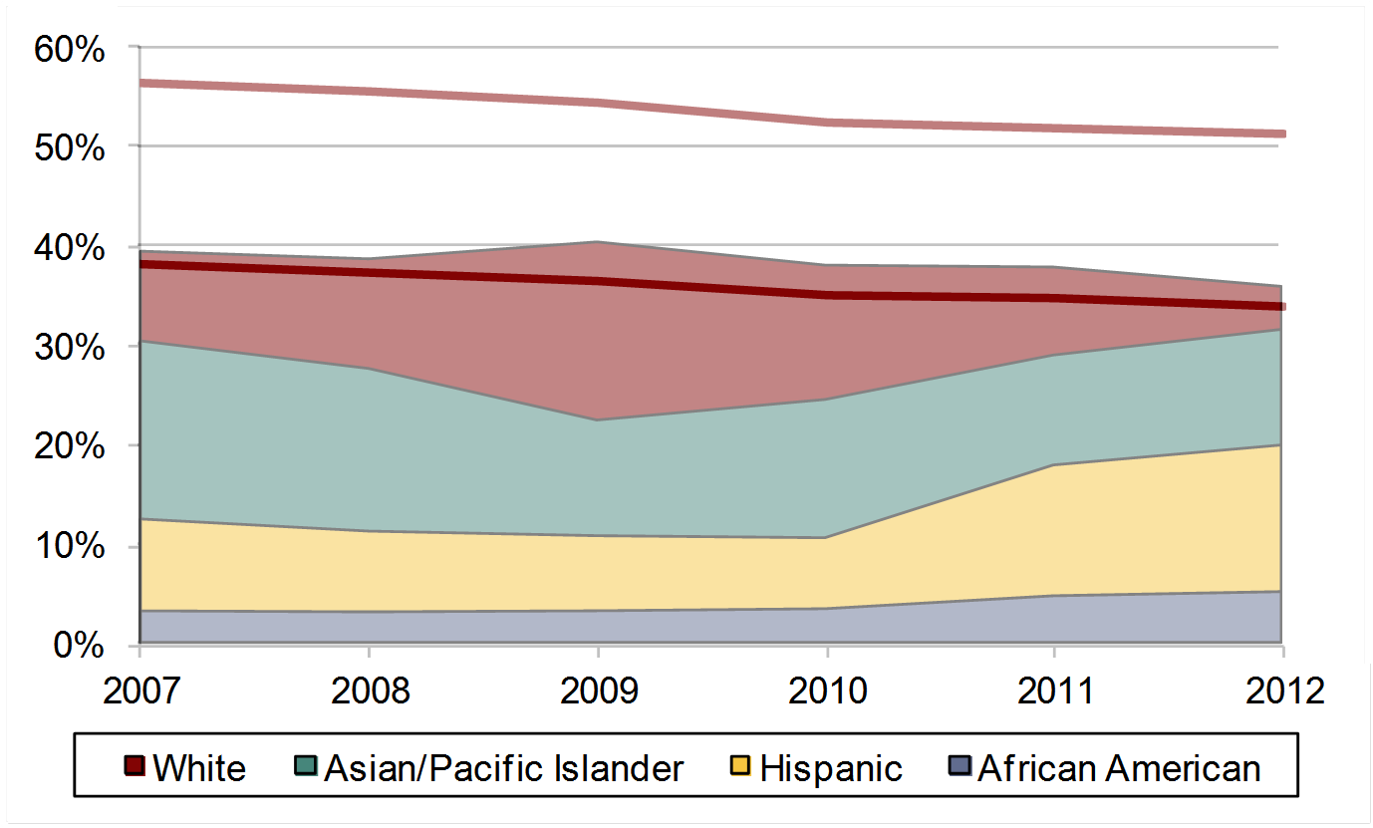
Foothill College Fall 2007-Fall 2012
Student Enrollment and Population
County and Service Area Overlay
Service Area
County
Notes:
Whites represent a higher percentage in Foothill’s service area than in Santa Clara County.
The percentage of white student enrollment falls between the level of Foothill’s service area and Santa Clara County, with enrollment more representative of the county percentage.
Percentage of White students enrolled has followed the decrease in Santa Clara county and Foothill’s service area.

Slide 6
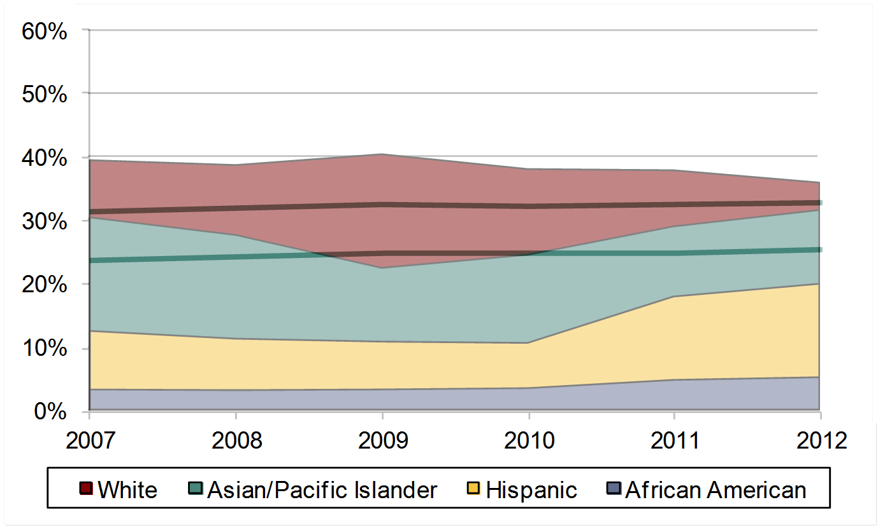
Foothill College Fall 2007-Fall 2012
Student Enrollment and Population
County and Service Area Overlay
County
Service Area
Notes:
Asian/Pacific Islanders have a higher presence in Santa Clara County than in Foothill’s service area.
Asian/PI student percentage has increased since 2009 while levels in region has stayed the same.
Asian/ Pacific Islander student enrollment falls between the level of Foothill’s service area and Santa Clara County, with enrollment more representative of the county percentage.

Slide 7
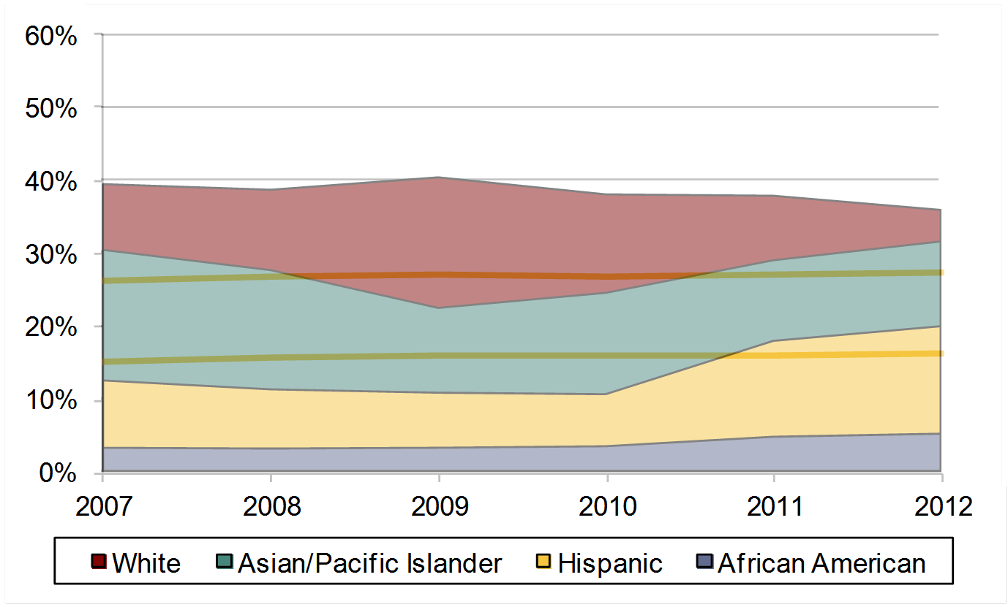
Foothill College Fall 2007-Fall 2012
Student Enrollment and Population
County and Service Area Overlay
County
Service Area
Notes:
A higher percentage of Hispanics are found in Santa Clara County than in Foothill’s service area.
While Hispanic enrollment has historically been below the level found in Santa Clara County and Foothill’s service area, from 2011 enrollment has become more representative of the percentages found in the region.

Slide 8

Foothill College Fall 2007-Fall 2012
Student Enrollment and Population
County and Service Area Overlay
Service Area
County
Notes:
The percentage of African Americans in Santa Clara County and Foothill’s service area have both been consistent around 3%.
The percentage of African Americans enrolled in Foothill has slowly been increasing and is higher than the percentages found in the region.

Slide 9
Foothill College Fall 2007-Fall 2012
Student Enrollment by Ethnicity
Notes:
Percentage of Filipino students has increased from 2.7% to 4.4%
Percentage of Native american students has remained less than 1%

Slide 10
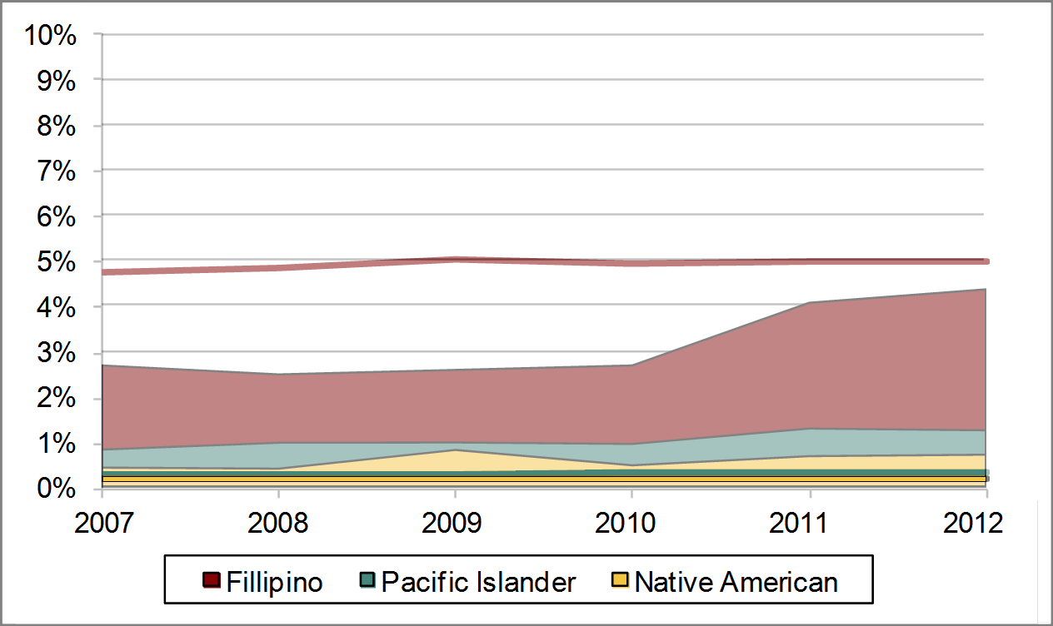
Foothill College Fall 2007-Fall 2012
Student Enrollment and Population
County and Service Area Overlay
County Filipinos
County PIs
County Native Americans
Notes:
Student enrollment percentages for pacific Islander and native Americans is higher than the region
Percentage of Filipino students has increased but is still below that of the county

Slide 11
Part II: Foothill Students and Employees

Slide 12
Total Enrollment
African American Enr.
Asian/Pac Isl Enr.
Filipino Enr.
Latino/a Enr.
White Enr.
Admin
Faculty
Latino/a Faculty
Staff
IR&D District Website Fall 2007 to 2012
Notes:
The overall headcount of fall enrollments shows a relatively steady decline from 2007 to 2012 (-21%).
There was an increase in Latino (23%), African American (24%) and Filipino (27%) enrollment headcount.
The decline in student headcount is mainly due to decline in White (-30%) and Asian/P (-25%).
Same decline noticed in Faculty (-10%) and Staff (-25%) headcounts.
However, the Admin headcount shows an increase (18%).
The increase headcount in Latino students’ enrollment mirrors the increase in Latino faculty (26%, the only faculty ethnicity that shows increase from 2007-2012).

Slide 18
Summary
Data shows us trend lines and historical patterns
Must consider how this information informs goals related to student equity
Ethnicity is just one piece of equity
Exploration on other characteristics are needed

Slide 19
Implications
What’s the goal?
What interventions can be attempted?
Unpackage issues related to equity
Representation: Who is here?
Outcomes: What happens to those who are here?

