Slide 1
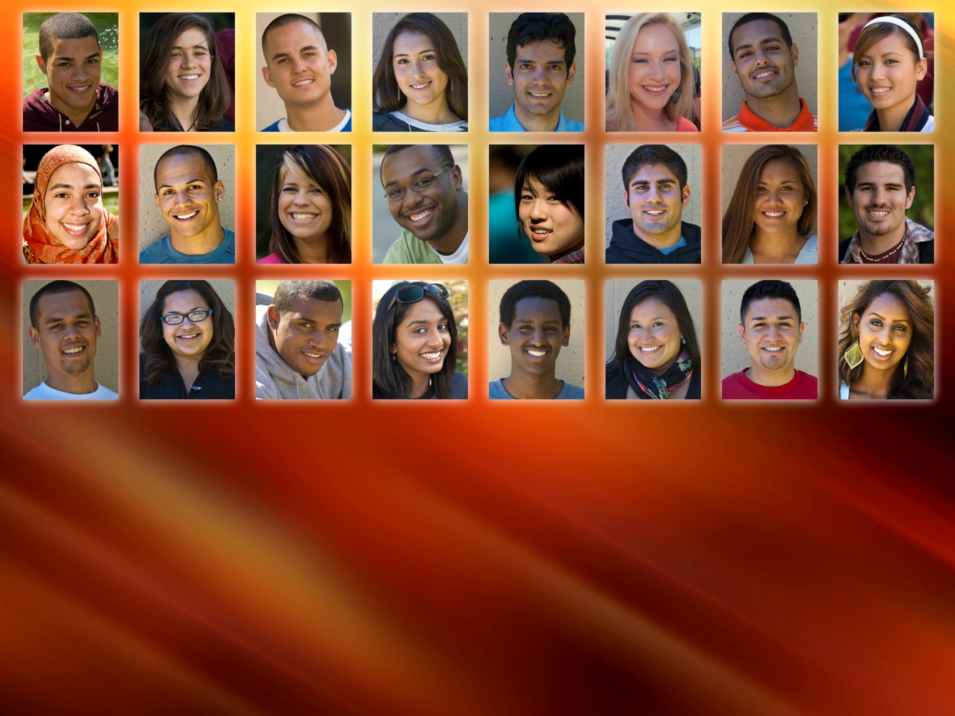
Faculty Inquiry Tool
Presented to Foothill Academic Senate
Mallory Newell, Institutional Research and Planning De Anza College

Slide 2

Capabilities
By academic year or term:
Course enrollment
Success Count
Non Success Count
Withdraw Count
Retention Count
Success rate
Retention rate
Disaggregation by student characteristics
Drill down to section level

Slide 3
Disaggregation – Student Level
Gender
Ethnicity
Age
Educational Goal Student Type (first time student, returning, continuing, etc.)
Low income
DSPS
Foster Youth
CalWorks
Veteran
Basic skills status
Financial aid status (All, BOG, PELL)

Slide 4
Disaggregation – Course Level
Course
Department
Division
Subject
Basic Skills Course
Degree Applicable Course
Transferable Course
Vocational Course
Online Education Course

Slide 5
Drill Down Capabilities
The tool will only be accessible through MyPortal (password protected)
Faculty can drill down to their own section level but they can only see their own sections, but can compare to all other sections aggregated
Deans may have access to all faculty within their division
Staff will be able to see course level, not section level detail.

Slide 6
Let’s Take a Look……
*Special thank you to Cabrillo College for sharing their tool and screen shots.

Slide 7
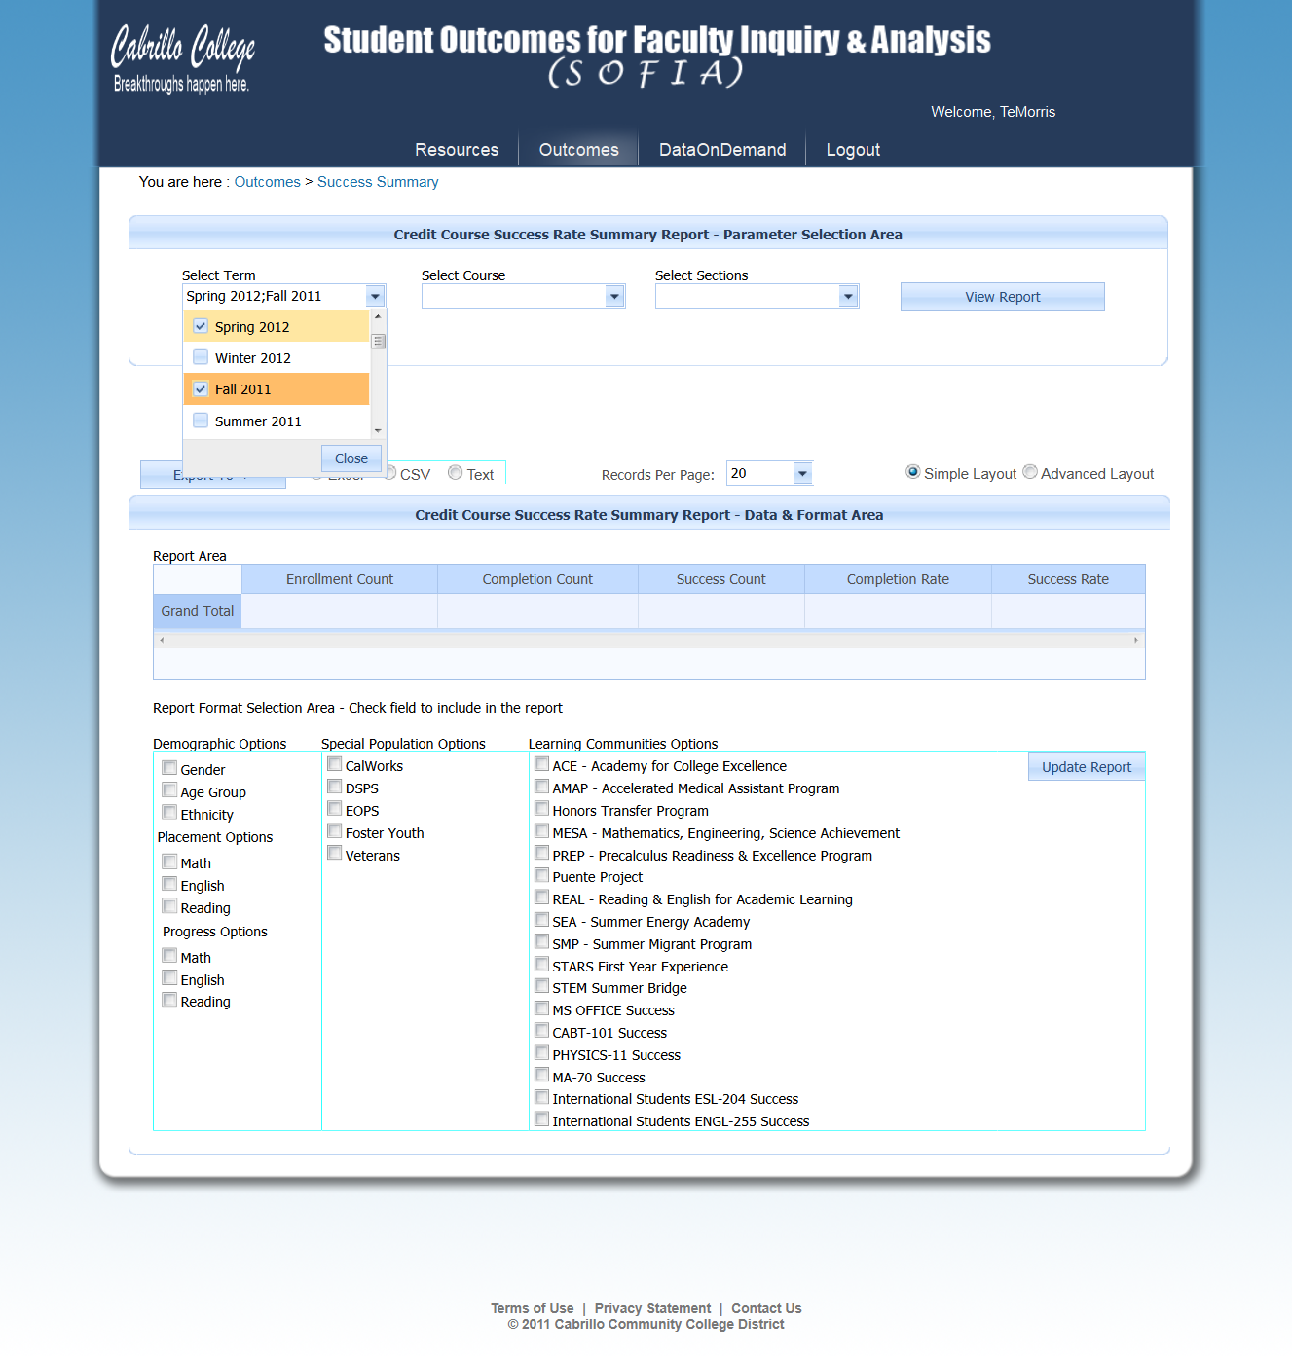

Slide 8
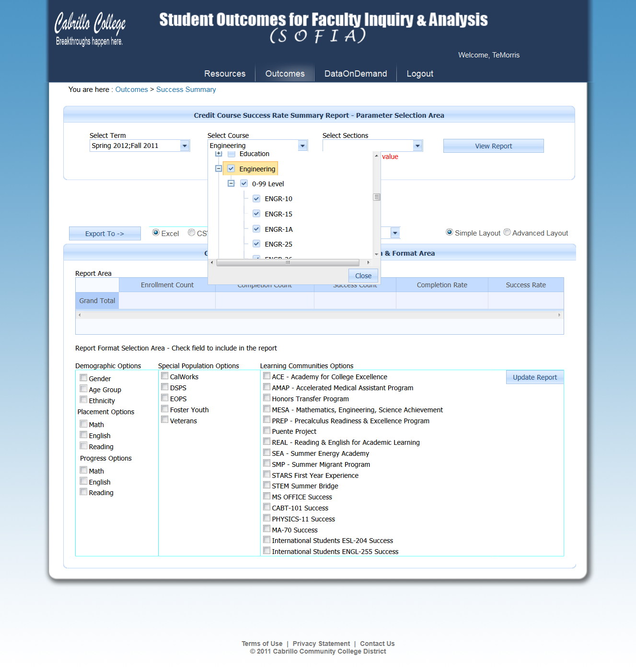

Slide 9
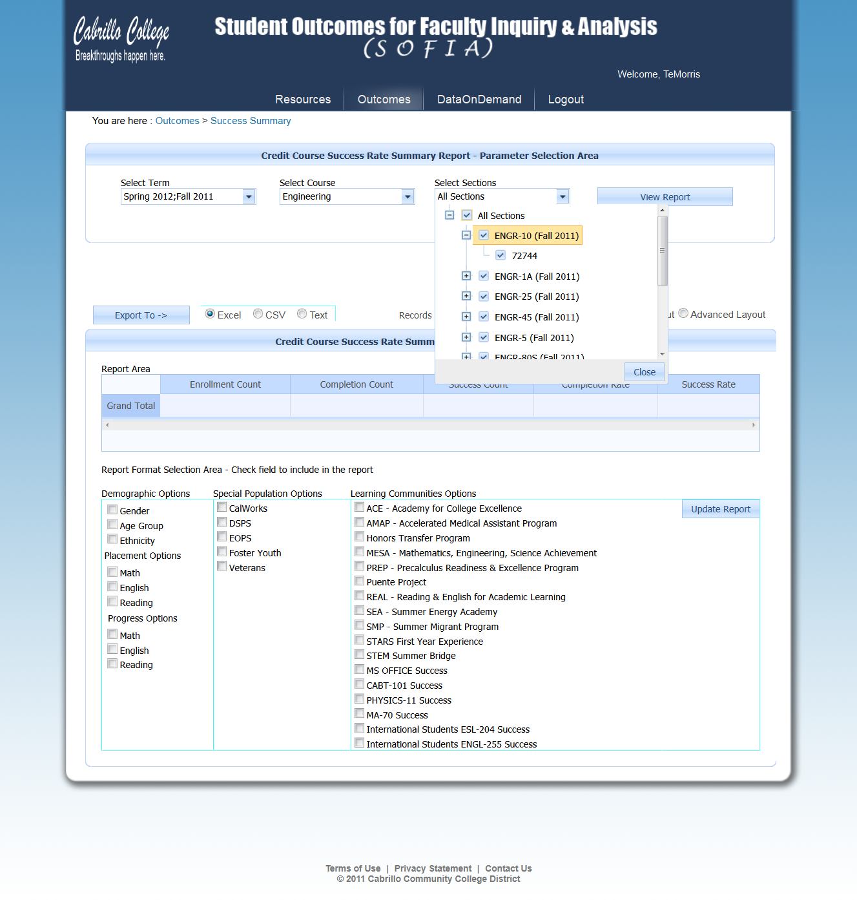

Slide 10
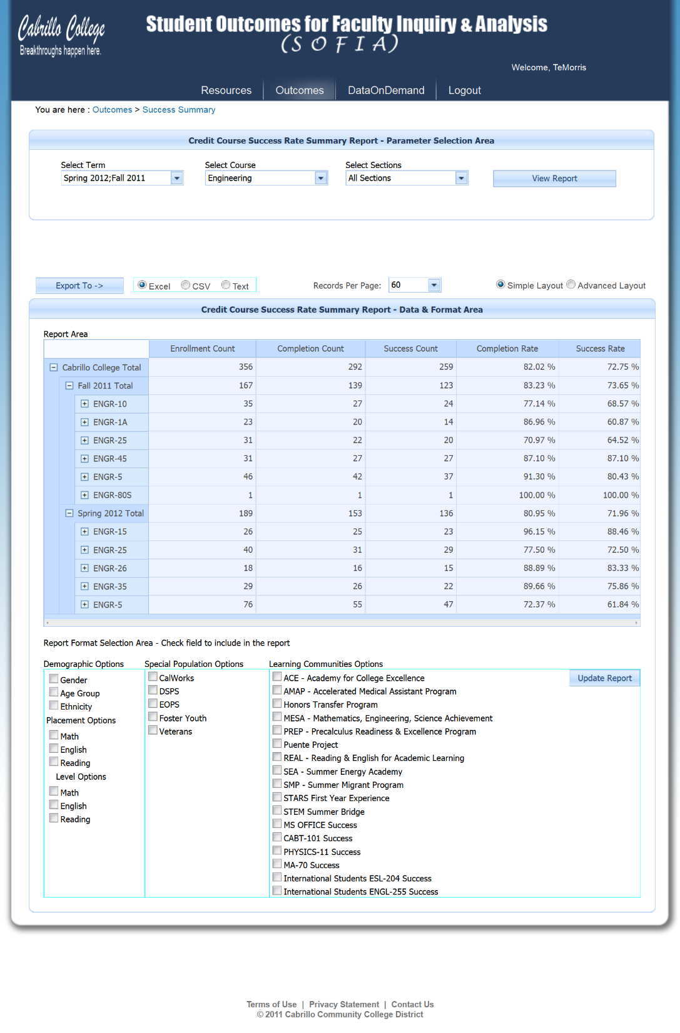

Slide 11
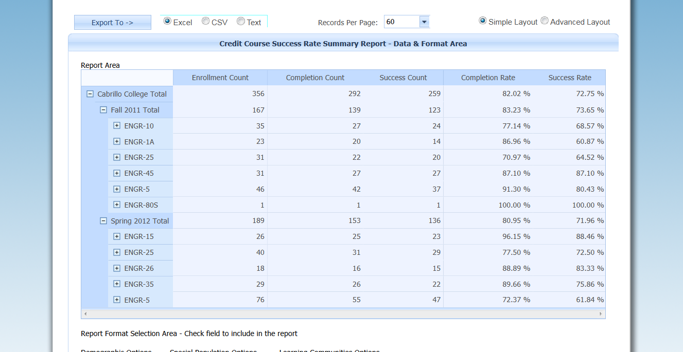

Slide 12
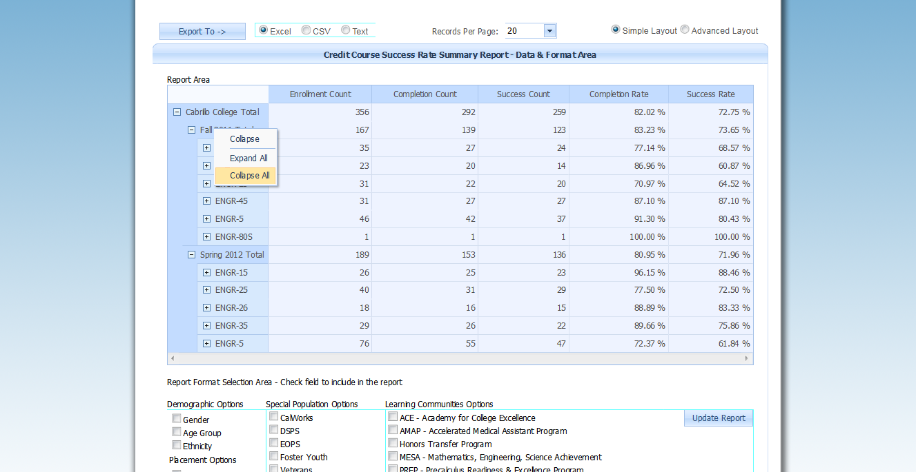

Slide 13
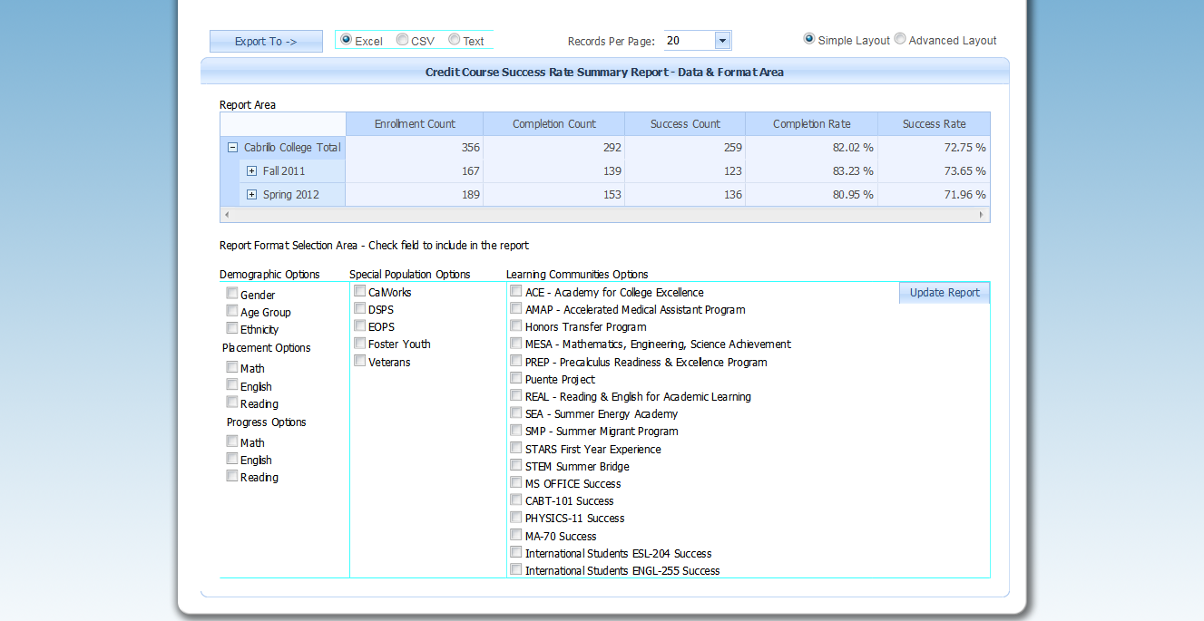

Slide 14
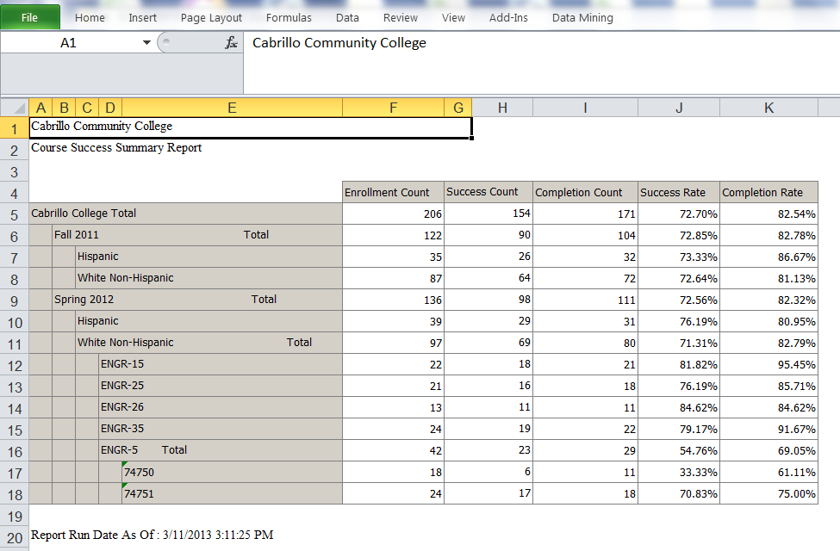
Export to Excel!

Slide 15
Costs
Commitment of $45k from each college for start up fees
Additional ongoing maintenance and upgrades between $5k and $15k per year (pending what the colleges want to add to it and if additional ETS staff is hired through 3SP funding)
De Anza has committed $60K upfront from Basic Skills Initiative funding to get it started

Slide 16
Roll Out
Faculty trainings will take place in Fall 2015
Once trained, faculty will receive access to the tool
Peer-to-Peer trainings to expand access to the tool

Slide 17
Timeline
Approval from Foothill by late February
Interface developed by March/April
Share with colleges in May/June for feedback
Finalize tool and test in summer
Fall 2015 start trainings with limited users
Winter and spring 2015 – expand trainings and users
Ongoing – development of 2.0 version

Slide 18
Version 2.0
Develop a wish list as we go:
Placement data
Cohort tracking (learning communities, upload student ids)
Track students in regards to a course they started in and where they end up
Student services categories
Enrollment priorities categories
Majors

Slide 19
Questions?
Mallory Newell
408-864-8777
newellmallory@deanza.edu

