Slide 1
Online Resource Usage Data @ Foothill College
3SP Advisory Group November 11, 2015

Slide 2
Smarthinking Usage Oct 2015
Hours Purchased | Hours Used | Number of Sessions | Number of Distinct Users | Average Hours Per Student | Average Sessions Per Student
600 | 67.00 | 101 | 37 | 1.81 | 2.73

Slide 3
Smarthinking Usage Oct 2015
Subject | Sessions | Total Time(minutes)
Algebra | 16 | 502
Basic Math Skills | 2 | 28
Calculus Single Variable | 23 | 1019
Career Writing | 1 | 42
Essay Center | 7 | 294
General Chemistry | 20 | 884
Geometry & Trigonometry | 4 | 222
Grammar & Documentation Review | 3 | 126
Paragraph Submission | 2 | 54
Physics | 9 | 410
Reading | 1 | 63
Research and Documentation | 1 | 26
Resume or Cover Letter | 1 | 42
Statistics | 4 | 105
Statistics w/ Audio | 1 | 37
Writing (All Subjects) | 6 | 166
Total in Hours | 101 | 67

Slide 4
Smarthinking User Demographics Oct 2015
Gender | F |  | M |  | Total
Age | # | % | # | % | # | %
18 - 21 | 11 | 30% | 10 | 27% | 21 | 57%
22 - 25 | 4 | 11% | 4 | 11% | 8 | 22%
26 - 29 | 1 | 3% | 1 | 3% | 2 | 5%
30 + | 4 | 11% | 2 | 5% | 6 | 16%
Total | 20 | 54% | 17 | 46% | 37 | 100%

Slide 5
Foothill Student Success Scorecard
Age | % Foothill Students
Less than 20 years old | 22.4%
20 to 24 years old | 34.1%
25 to 39 years old | 28.2%
40 or more years old | 15.3%
Unknown | 0.1%

Slide 6
Smarthinking User Demographics Oct 2015
Race | # | %
Asian | 20 | 62%
Black or African American | 2 | 3%
Hispanic | 3 | 2%
Other Asian | 1 | 3%
Two or more races | 4 | 11%
White or Caucasian | 7 | 19%

Slide 7
Foothill Student Success Scorecard
Race | % Foothill Students
African American | 3.6%
American Indian/Alaska Native | 0.2%
Asian | 23.9%
Filipino | 3.4%
Hispanic | 21.4%
Pacific Islander | 0.7%
White | 35.5%
Two or more Races | 4.8%
Unknown | 6.5%

Slide 8
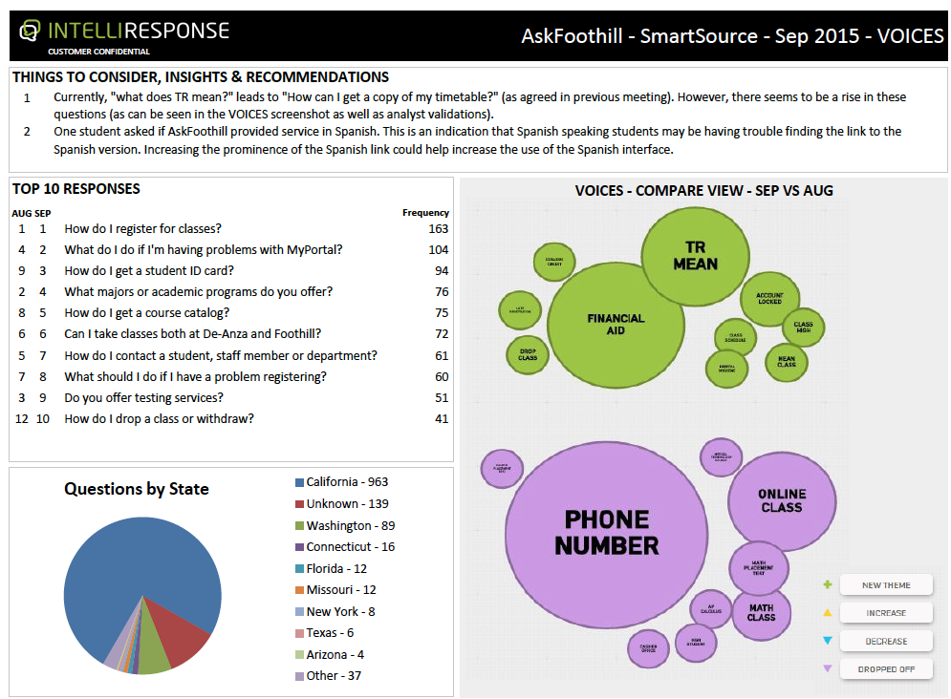
Ask Foothill- September

Slide 9
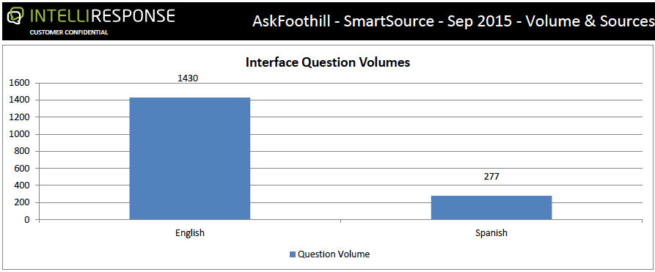
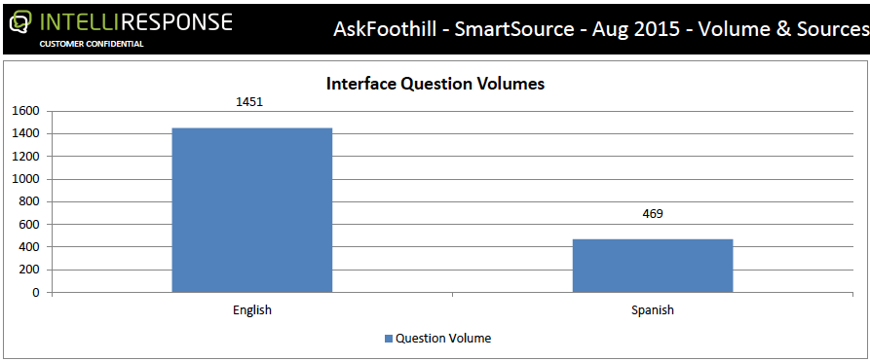
Ask Foothill

